Slide 1
Bilateral Second Branchial cleft anomalies/ sinuses type III
Dr. Doaa Khedr Mohamed & Dr. Amr Nabil*
Specialist of radiology farwaniya hospital
* Consultant of radiology farwaniya hospital

Slide 2
4 year old diabetic female with recurrent sinus on the skin for about 1 year. She performed CT and MRI for assessment. Then referred to surgical unit.
2nd branchial cleft anomalies : commonly presented as cyst but can be fistula or sinus. Most are present within the submandibular space but they can occur anywhere along the course of the second branchial arch tract which extends from the skin overlying the supraclavicular fossa, between the internal and external carotid arteries, to enter the pharynx at the level of the tonsillar fossa.
According to baily classification: Type III – Extends medially between the bifurcation of the internal and external carotid arteries, lateral to the pharyngeal wall.

Slide 3
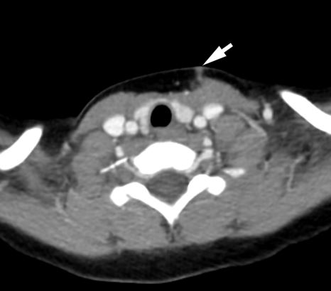
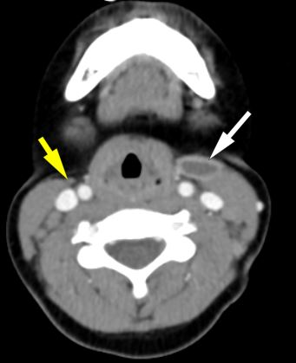
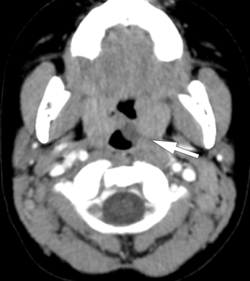
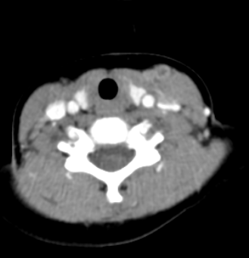
A
C
D
B
A to D axial post contrast CT scan of the neck revealed left marginally enhancing sinus tract seen extending from lower neck to the level of pharyngeal mucosal space (white arrows). There is a smaller similar mildly enhancing lesion seen on the right side.

Slide 4
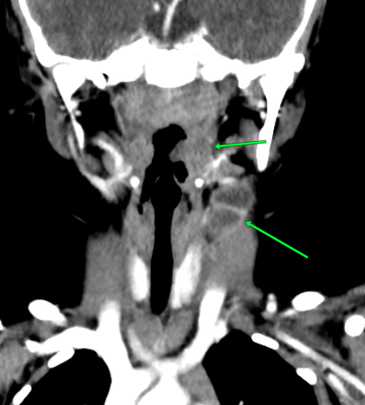
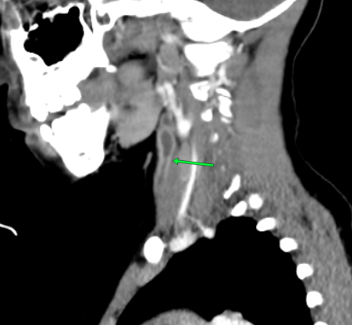
E
F
E&F coronal and sagittal contrast enhanced CT confirm the marginally enhancing sinus extends to pharyngeal mucosal space and the level of the palatine tonsils (green arrows)

Slide 5
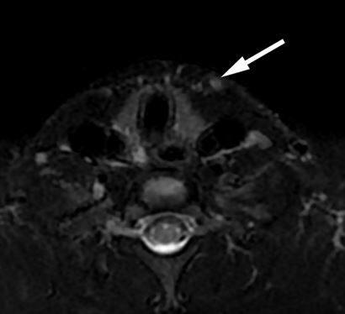
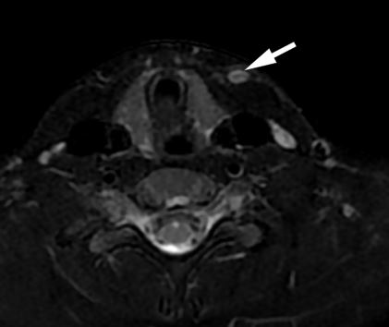
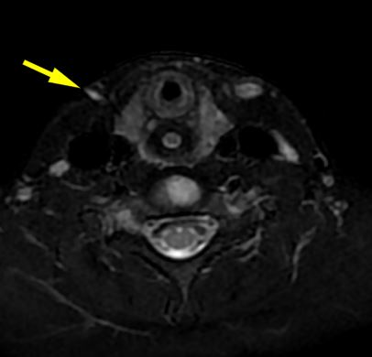
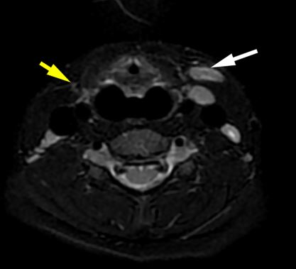
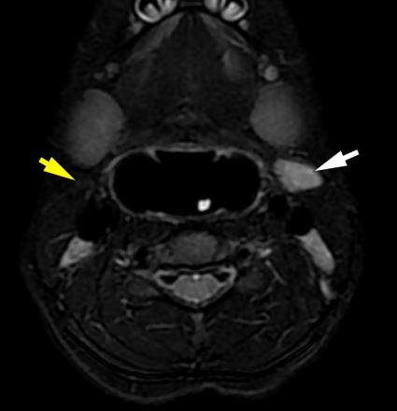
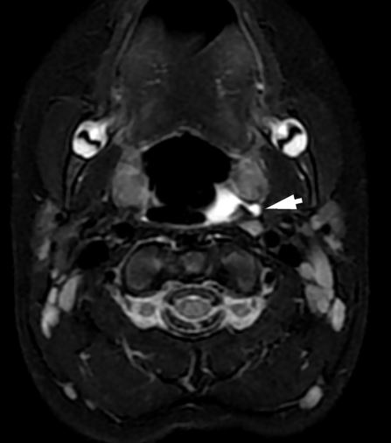
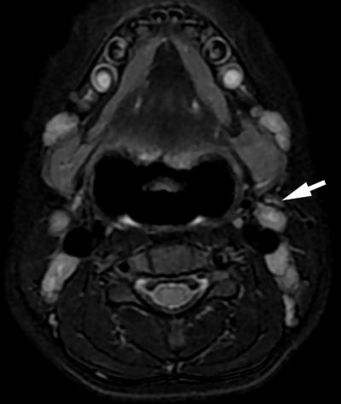
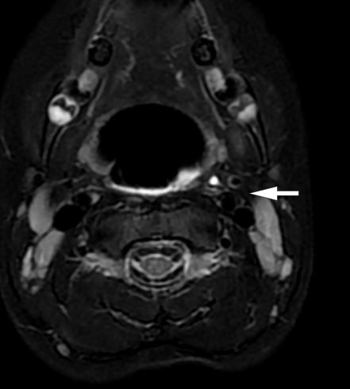
Axial STIR images show the extension of the neck sinuses form the level of thyroid gland upward in-between the ICA and ECA.

Slide 6
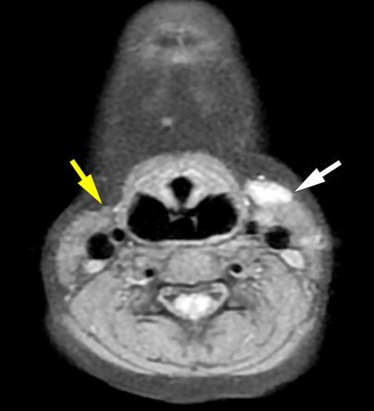
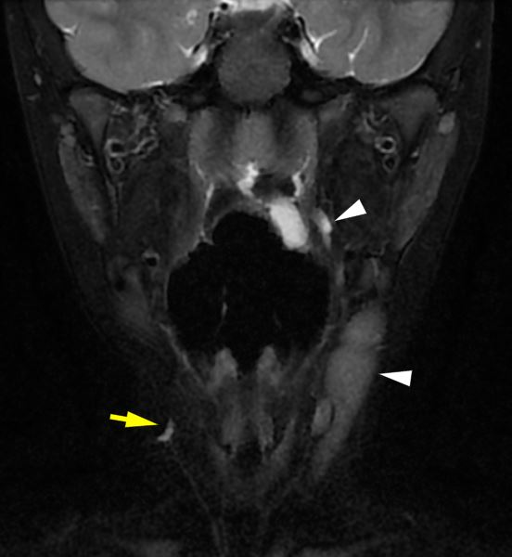
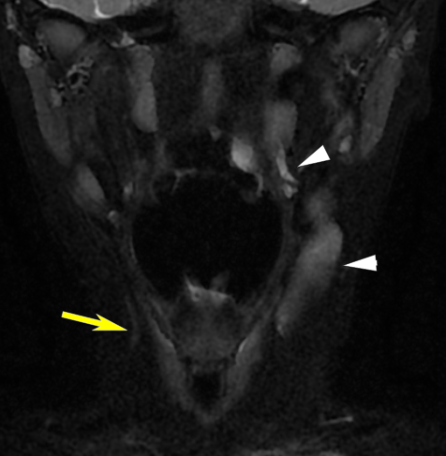
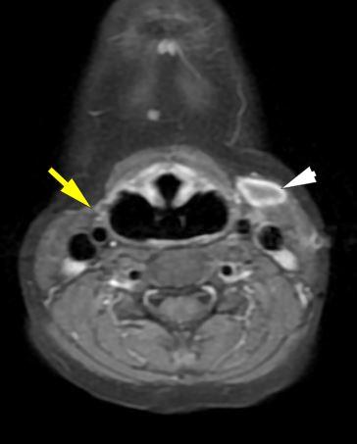
Coronal STIR images show the extension of the sinuses form the level of thyroid gland upward in-between the ICA and ECA on the left and right sides.
Axial pre and post contrast T1 Fat SAT reveals marginal enhancement of the left side.

Slide 7
References:
Waldhausen JHT. Branchial cleft and arch anomalies in children. Seminars in Pediatric Surgery. 2006;15(2):64-69. doi:https://doi.org/10.1053/j.sempedsurg.2006.02.002
Adams A, Mankad K, Offiah C, Childs L. Branchial cleft anomalies: a pictorial review of embryological development and spectrum of imaging findings. Insights into Imaging. 2015;7(1):69-76. doi:https://doi.org/10.1007/s13244-015-0454-5
Bailey, H. (1929) Branchial Cysts and Other Essays on Surgical Subjects in the Fascio-Cervical Region. H.K. Lewis & Company Ltd., London. - References - Scientific Research Publishing. Scirp.org. Published 2023. Accessed January 17, 2025. https://www.scirp.org/reference/referencespapers?referenceid=3478454

