Slide 1
Parapharyngeal pleomorphic adenoma(minor salivary glands)
Dr. Safwat almoghazi MD
Dr Ahmad khaliel FRCR
Dr Ajaya Raj Pande MD PhD
Adan radiology department.

Slide 2
Case synopsys and Final Diagnosis
Patient: An 18-year-old female presenting with an incidental, painless throat bulge.
Clinical and Radiological Findings: Pleomorphic adenomas in the parapharyngeal space (PPS) are rare, benign tumors often arising from minor salivary glands.(1,2)
CT imaging revealed a well-circumscribed mass in the prestyloid compartment, displacing adjacent structures such as the pharyngeal wall without invasion. The mass displayed homogeneous soft tissue density, with mild post-contrast enhancement.
MRI showed a large lesion with low-to-intermediate T1-weighted and high T2-weighted signals, consistent with myxoid and chondroid components. Post-contrast imaging demonstrated heterogeneous enhancement. The lesion displaced the internal carotid artery, internal jugular vein posteriorly, and the pharyngeal wall medially without infiltration.
Differential Diagnosis: Pleomorphic adenomas should be differentiated from other PPS tumors such as schwannomas and paragangliomas. Favorable indicators include a prestyloid location, well-defined margins, and characteristic MRI signal intensities.
Pathology Findings: Surgical excision yielded a fragmented, firm mass measuring 8.4 x 8.2 x 2.4 cm. Histopathology confirmed a pleomorphic adenoma composed of myoepithelial cells and glandular structures within a myxoid stroma. No malignancy was detected, and excision margins were clear.(5)
Treatment and Prognosis: Complete surgical excision was performed and the patient has an excellent prognosis with minimal recurrence risk.
Conclusion: Pleomorphic adenoma of the minor salivary gland in the parapharyngeal space. This case underscores the rarity of such tumors in the PPS, accounting for approximately 0.5% of head and neck neoplasms, with pleomorphic adenomas representing the most common benign salivary gland tumors in this region. Complete surgical excision with clear margins is the treatment of choice to minimize recurrence risk (2,3)

Slide 3
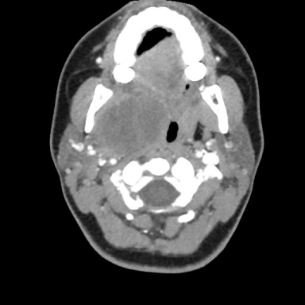
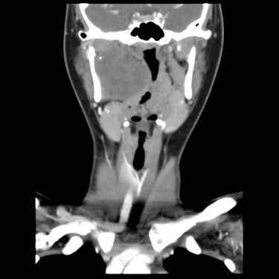
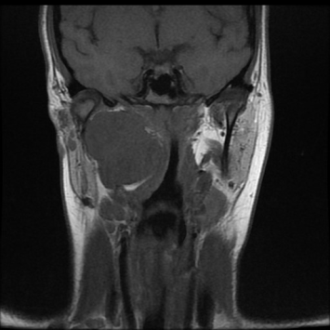
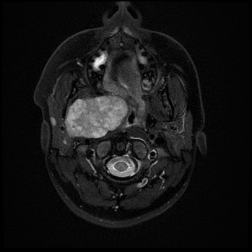
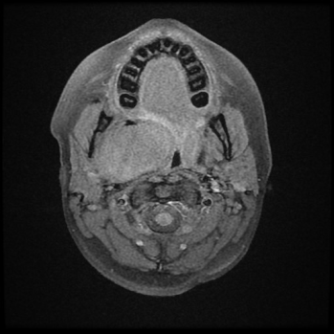
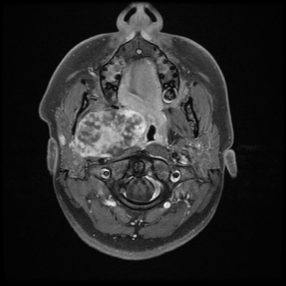
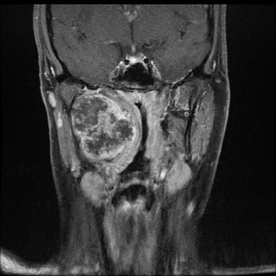
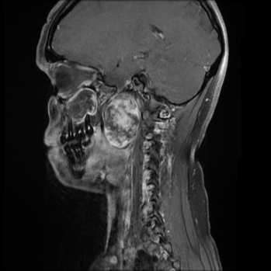
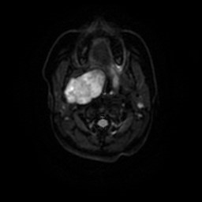
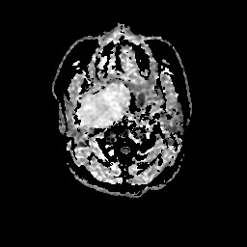
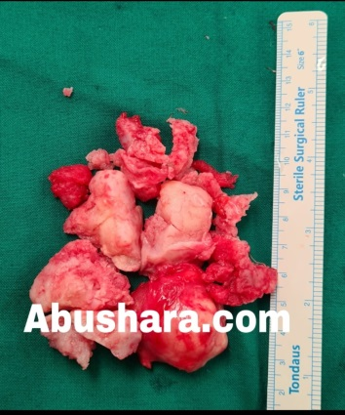
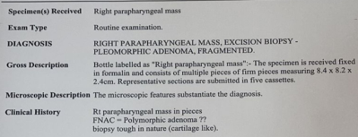
Parapharyngeal pleomorphic adenoma (minor salivary glands
CT Findings: The lesion appears as a well-circumscribed , soft tissue density lobulated mass with areas of calcification located mainly in the right parapharyngeal space. The mass is displaceing surrounding anatomical structures, such as the oropharyngeal airway, without evidence of invasion.
MRI Findings: The lesion exhibits low signal intensity on T1 surronded with compressed PPS fat ( blue arrows) and high signal intensity on T2, reflecting its myxoid and chondroid matrix components. There is heterogeneous enhancement after gadolinium administration, indicating the tumor’s mixed tissue composition. Do not exhibit restricted diffusion.
Diagnosis: Parapharyngeal pleomorphic adenoma(minor salivary glands).
Axial NECT
Axial CECT
Coro CECT
Cor T1WI
Axial T2 FS
Axial T1 FS
Axial T1+C
Cor T1+C
Sagit T1+C
DWI
ADC

Slide 4
References:
1. Papadogeorgakis N, Petsinis V, Goutzanis L, Kostakis G, Alexandridis C. Pleomorphic Adenomas of the Parapharyngeal Space: Report of Three Cases. Case Rep Med. 2012;2012:373508. PMC
2. Joshi A & Ray C. Primary Pleomorphic Adenoma of Minor Salivary Gland in the Parapharyngeal Space. An International Journal of Otorhinolaryngology Clinics. 2016;8(3):125-7. <a href="https://doi.org/10.5005/jp-journals-10003-1249">doi:10.5005/jp-journals-10003-1249</a>
3. Akın I, Karagöz T, Mutlu M, Sahan M, Onder E. Pleomorphic Adenomas of the Parapharyngeal Space. Case Rep Otolaryngol. 2014;2014:168401. <a href="https://doi.org/10.1155/2014/168401">doi:10.1155/2014/168401</a> - <a href="https://www.ncbi.nlm.nih.gov/pubmed/25140265">Pubmed</a>
4. Pathology Outlines - Pleomorphic adenoma. Accessed January 15, 2025. PathologyOutlines.com

