Slide 1
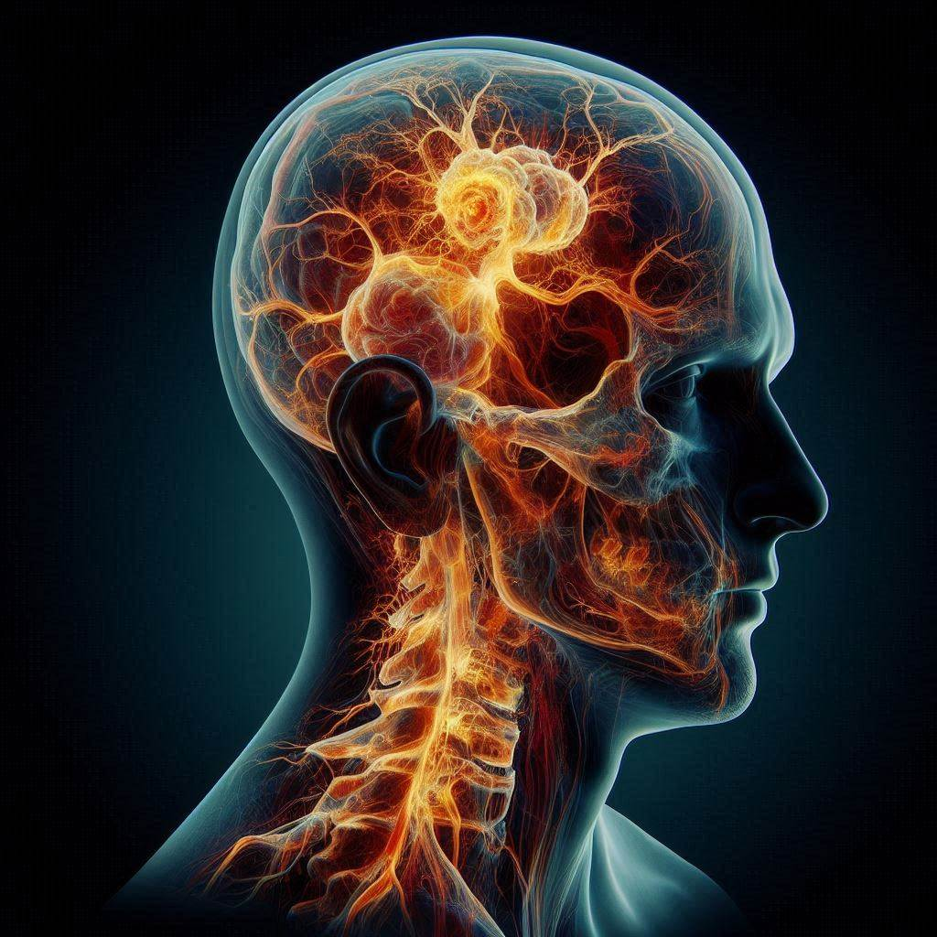
Proptosis Puzzle When First Impressions Mislead
A Case of Spontaneous Intra-Orbital Hematoma Mimicking Sinusitis-Associated Fungal Infection
Authors: Ali H. Yusuf, Nawra Mujbel, Fatema Bushager, Ahmet Kaya
Affiliation: Salmaniya Medical Complex, Manama, Bahrain

Slide 2
Clinical Presentation:
5-year-old male with global developmental delay, on valproic acid for seizure disorder.
Symptoms: Progressive eye redness and protrusion (left>right) over 3 days.
Imaging Findings:
CT: Extensive pansinusitis with bilateral intra-orbital high-density subperiosteal collection.
Initial Diagnosis: Fungal sinusitis with intra-orbital extension
Operative Findings: Intra-orbital hematoma
Final Diagnosis: Spontaneous Intra-Orbital Hematoma
Likely related to valproic acid-induced coagulopathy
Management & Outcome:
Switched from valproic acid to levetiracetam.
Symptoms resolved post-operatively.

Slide 3
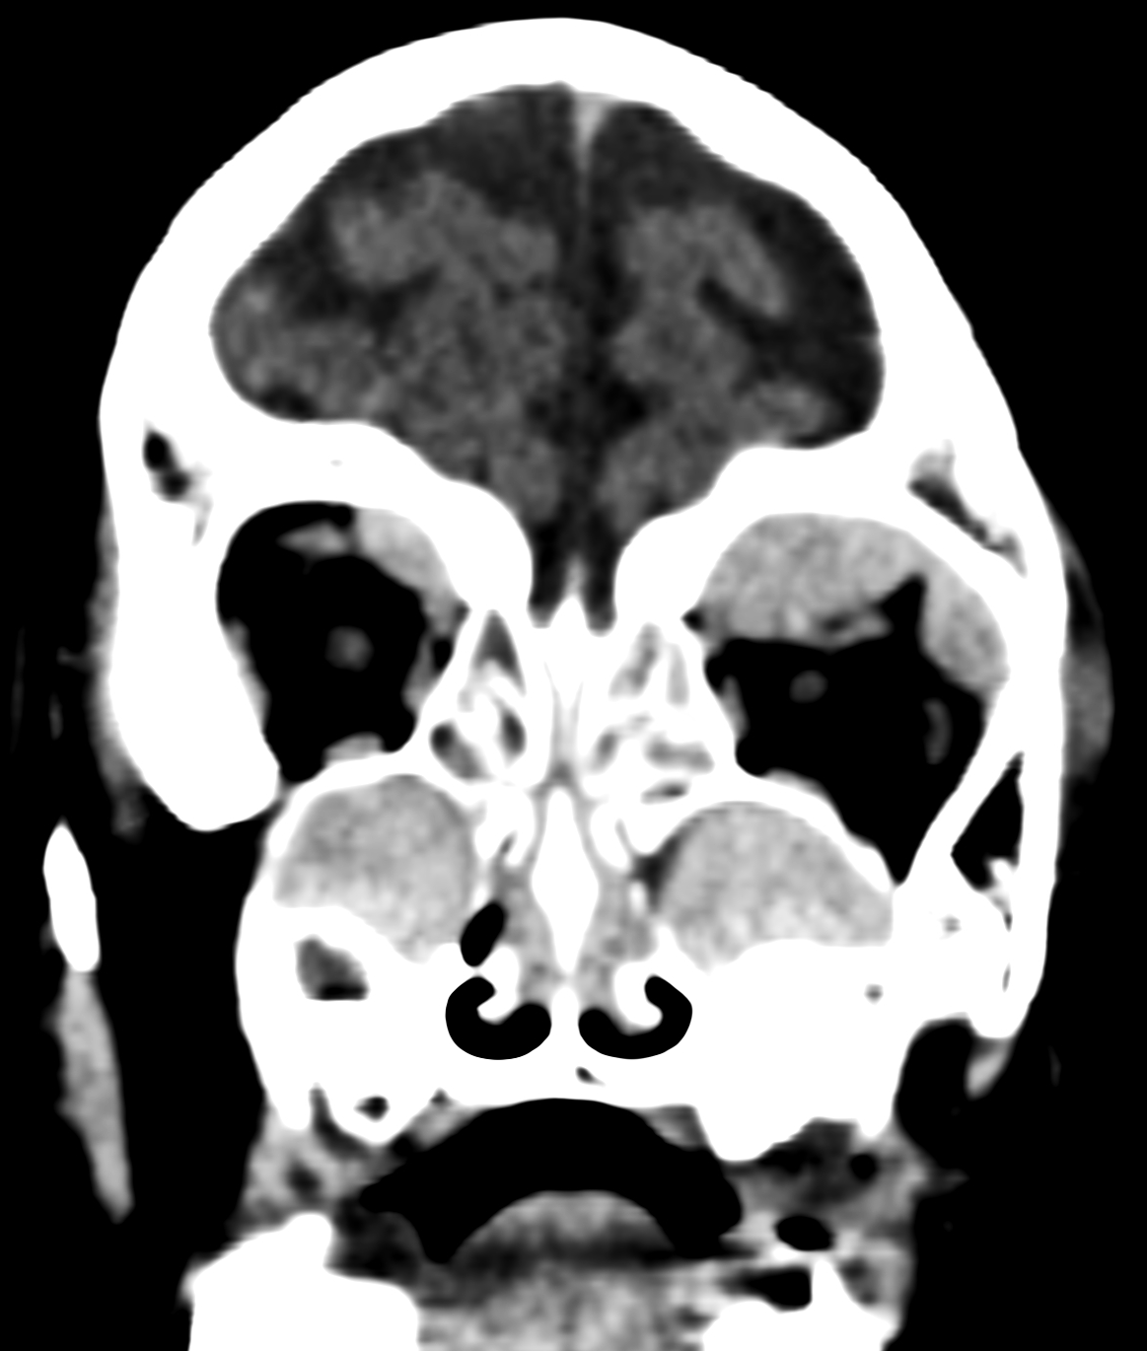
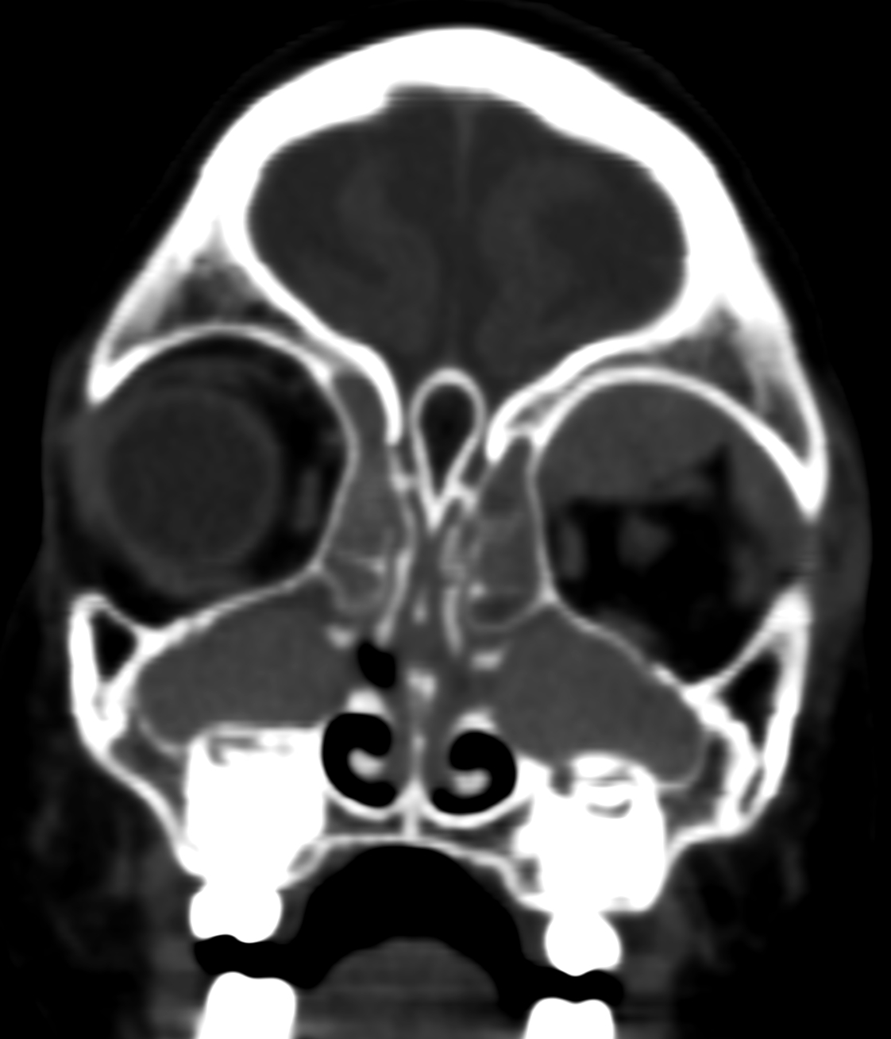
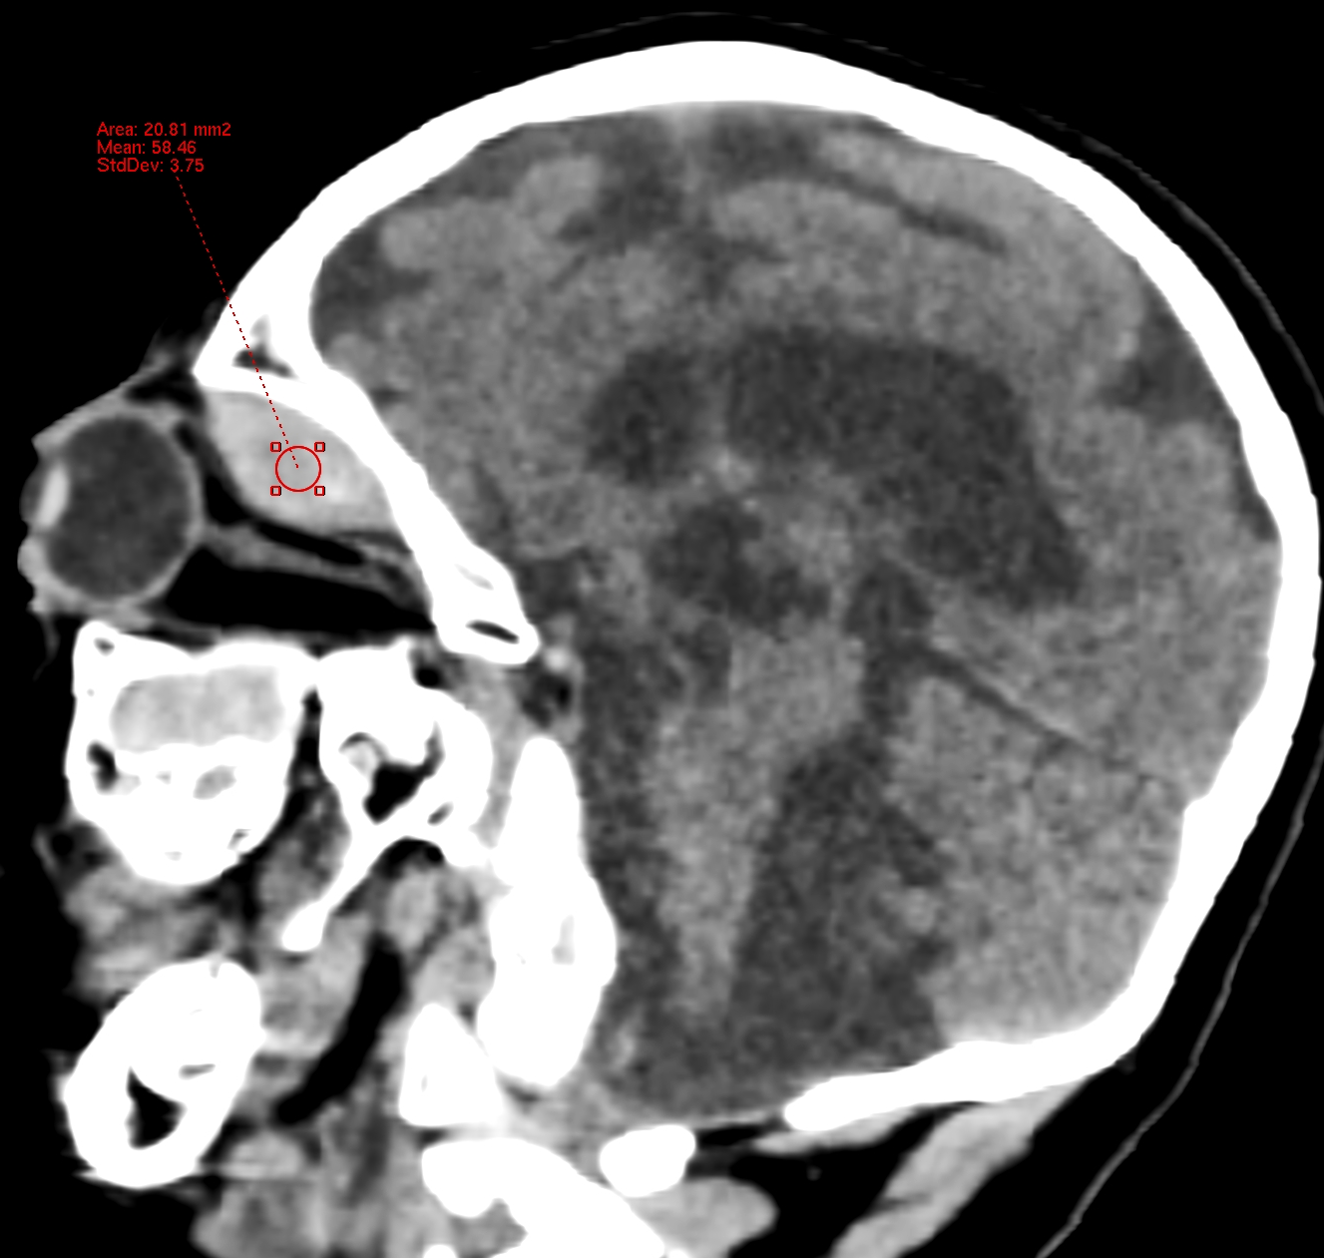
Clinical photograph showing bilateral periorbital ecchymosis and proptosis, more pronounced on the left side.
*
*
*
*
Sagittal and coronal CT images showing extensive sinus opacification (asterisk) and a high-density intra-orbital collection in the left orbit (arrow).

Slide 4
References (Similar Reported Cases)
Paramanathan V, Zolnourian A. Spontaneous intraorbital hematoma: case report. Clin Ophthalmol. 2010;5:1-2. Published 2010 Dec 16. doi:10.2147/OPTH.S15177
Martinez Devesa P. Spontaneous orbital haematoma. J Laryngol Otol. 2002;116(11):960-961. doi:10.1258/00222150260369552
Kwon JH, Song YJ, Choi SS, Kim KU. Spontaneous intraorbital hemorrhage: a case report. J Korean Neurosurg Soc. 2008;44(3):156-158. doi:10.3340/jkns.2008.44.3.156
Chan HHL, Hardy TG, McNab AA. Spontaneous Orbital Hemorrhage Related to the Extraocular Muscles. Ophthalmic Plast Reconstr Surg. 2019;35(3):256-261. doi:10.1097/IOP.0000000000001223

