Slide 1
Bilateral Lacrimal Gland Prolapse and Unilateral Subconjunctival Fat Prolapse
Dr. Ahmed Mahmoud Elzeneini
Senior Specialist
Sheikh Jaber Al Ahmad Hospital
Co-authors
Dr. Adnan Muhammad Naeem, Senior Registrar
Dr. Nada Ahmed Mohamed, Senior Registrar

Slide 2
Introduction
Lacrimal gland prolapse is defined as herniation of a normal gland from the lacrimal fossa; an underrecognized cause of lateral upper eyelid swelling.
The gland is secured in position by fibrous periosteal attachments and suspensory ligaments. Weakening of these supportive structures, due to aging, trauma and other causes of increased intra-orbital pressure, propagates prolapse.
It requires to be differentiated from other pre-septal mass lesions; correct diagnosis is key to avoid inadvertent surgical excision of the gland.
In some studies, it was reported that only 2 of 59 patients with lacrimal gland prolapse were diagnosed correctly before surgery; hence imaging is crucial in its diagnosis and exclusion of other lesions.
Subconjunctival fat prolapse, a disease little known to radiologists, is herniation of intraconal fat through the conjunctiva due to weakening of the tenon capsule, it occurs mainly in elderly obese men, presenting as soft yellowish mass.
Dermo-lipoma is the first differential for subconjunctival fat prolapse, presenting as firm non-mobile pinkish mass. Imaging separates it from intraconal fat and identifies its capsule.

Slide 3
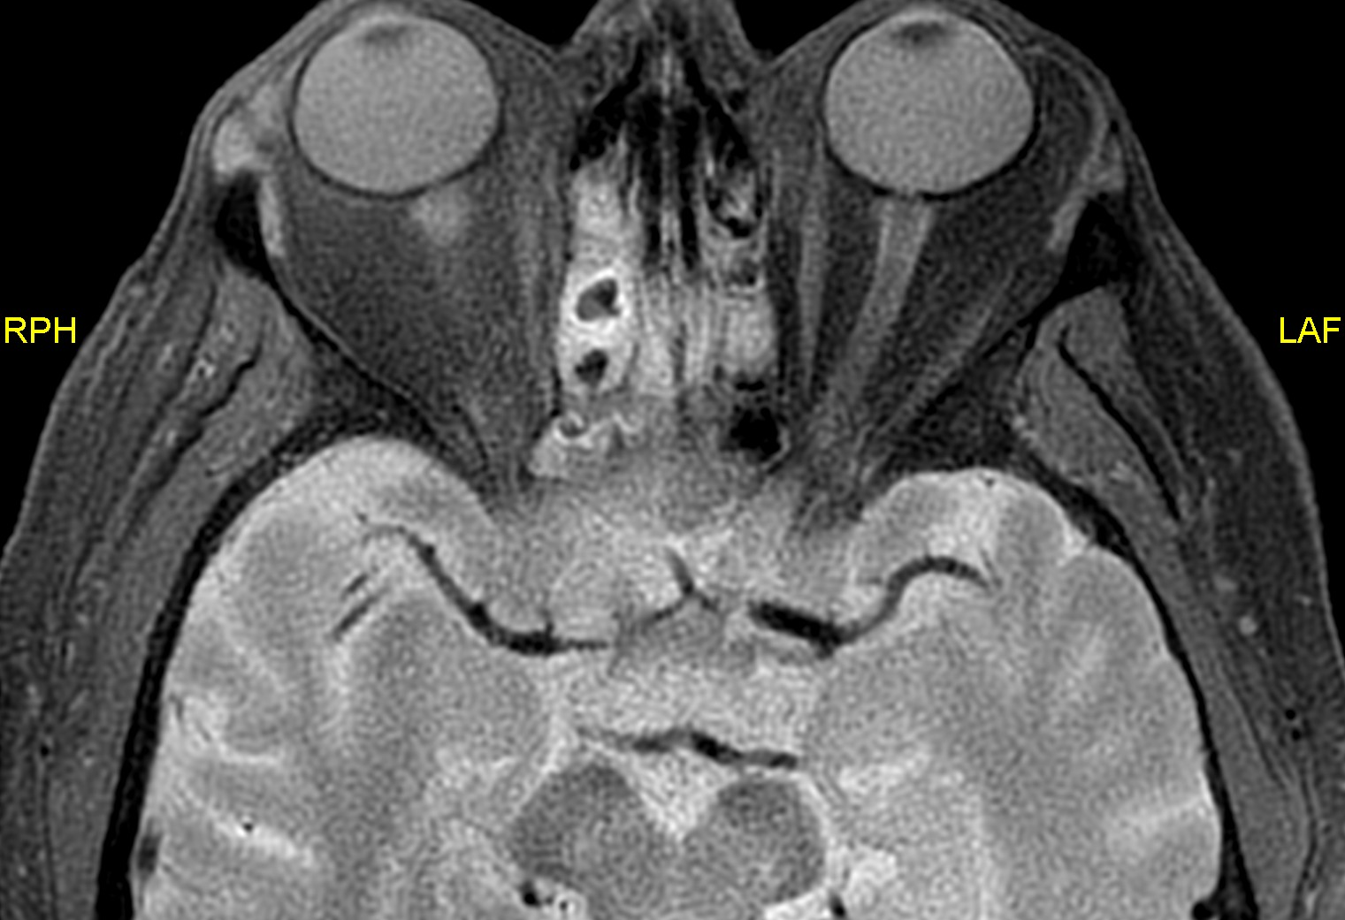
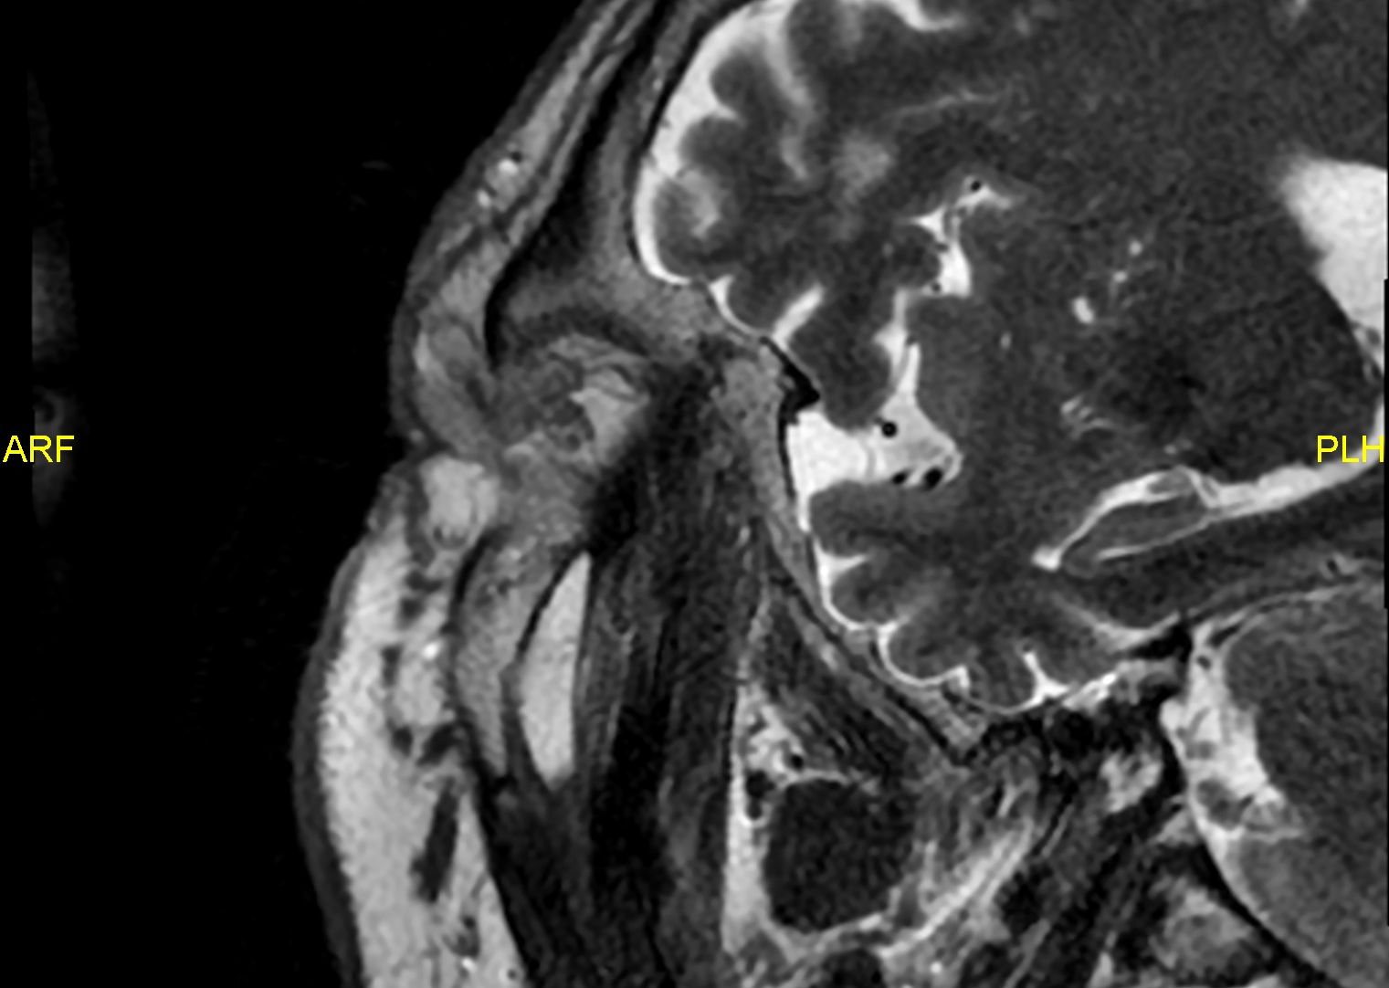
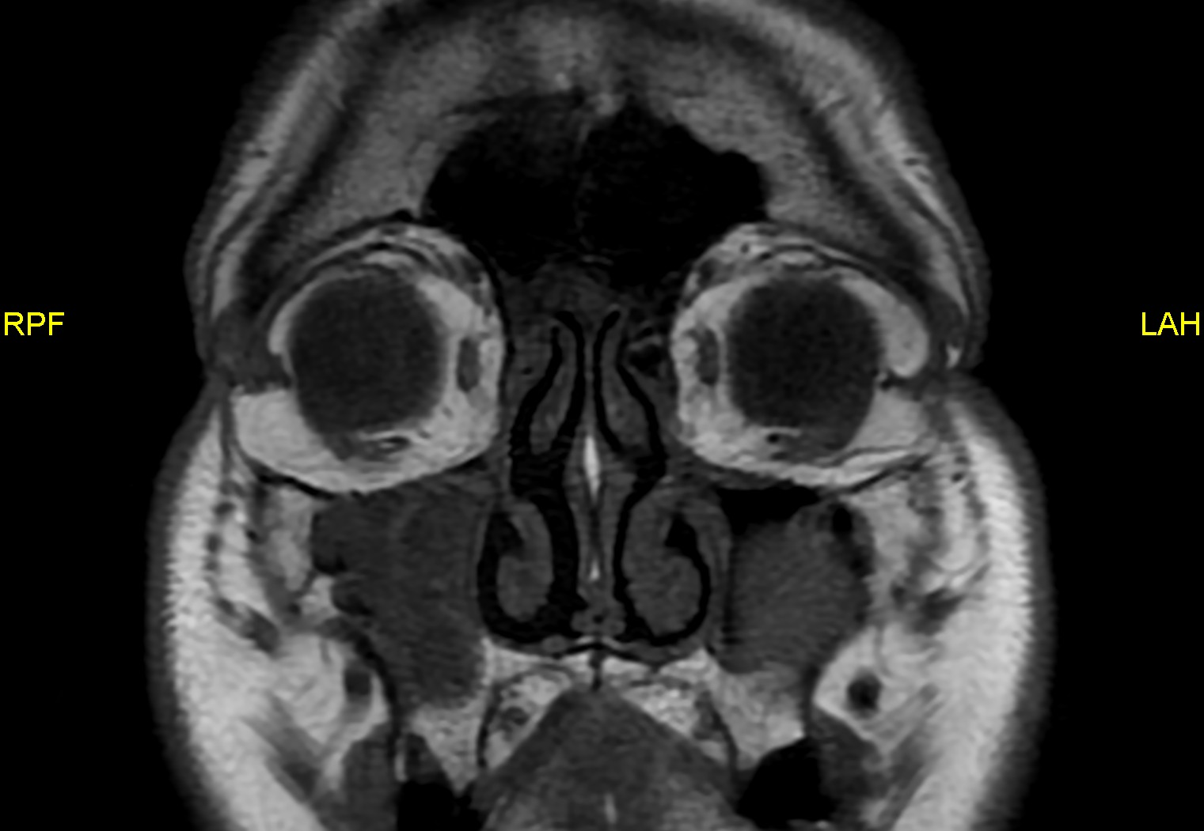
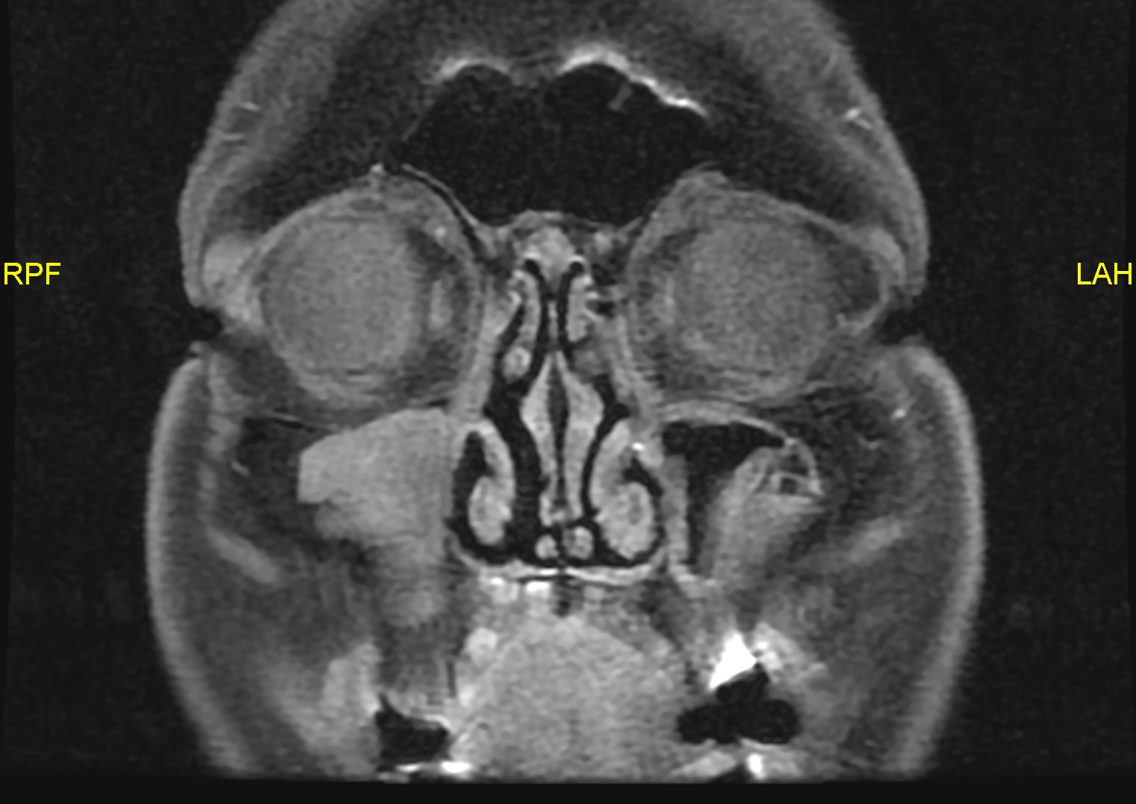
Case Scenario
LG
SF
64 M, with bilateral upper eyelid
fullness, with slowly growing left lateral swelling.
Examination:
-Left eye supero-temporal soft yellowish swelling, ? dermolipoma.
- Smaller right pinkish bulging mass along lateral palpebral conjunctiva.
MRI Findings:
Bilateral lacrimal glands ‘LG’ prolapse beyond superior orbital rim ‘SOR’, more evident on the right.
Left subconjunctival fat ‘SF’ prolapse seen continuous with intraconal fat.
Future plan:
Patient reassured. Future blepharoplasty with intraoperative lacrimal gland repositioning, and transconjunctival fat excision is planned.
SOR
LG
Axial PDFS
Sagittal T2
Coronal T1
Coronal T1FS
LG
SF
LG
SF

Slide 4
SF
LG
LG
SF
LG
Axial T2FS
Coronal T2FS
Axial T1
Axial T1FS
SF
SF
LG
LG

Slide 5
References
Naing EE, Myint KT, Roddi R. Lacrimal Gland prolapse: case report. Surgical Techniques Development. 2023;12(1):53-59. doi:10.3390/std12010004
Dobbs NW, Budak MJ, White RD, Zealley IA. MR-EYE: High-Resolution Microscopy COIL MRI for the assessment of the orbit and periorbital structures, Part 2: Clinical Applications. American Journal of Neuroradiology. 2021;42(7):1184-1189. doi:10.3174/ajnr.a7080
Kuruva M, Kumar M, Fitzgerald R, Samant R, Angtuaco EJ. Bilateral lacrimal gland prolapse: an underrecognized entity on CT. Neurographics. 2018;8(4):272-273. doi:10.3174/ng.1600015
Tejo CR, Da Costa PA, Batista RM, Rocha YRR, Borba MA. Subconjunctival fat prolapse: a disease little known to radiologists. Radiologia Brasileira. 2017;50(4):272-273. doi:10.1590/0100-3984.2015.0229

