Slide 1
Rare case of Metastatic synovial chondrosarcoma to the thyroid gland -surveillance and management.
Author:
Noura Alraeesi,MD.
King Abdulaziz medical city.
Ministry of National Guard Health Affairs, Riyadh, Saudi Arabia.

Slide 2
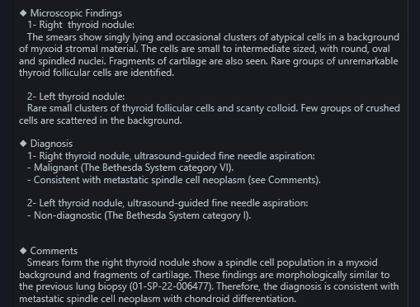
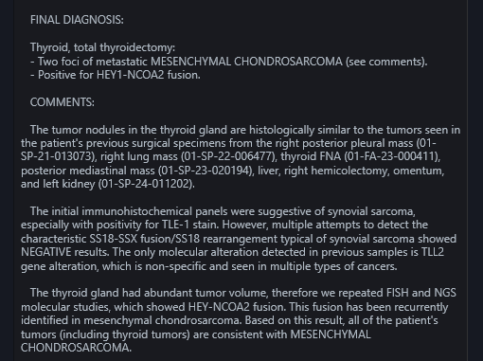
CASE SYNOPSIS
History
40 year old lady presented with weight loss and pancytopenia 4 years ago.
Imaging
Enhanced CT chest, abdomen and pelvis: showed a large lobulated mediastinal calcified mass with multiple calcified peritoneal metastatic lesions.
Enhanced CT neck: showed bilaterally enlarged thyroid lobes with multiple bilateral partially calcified nodules. No cervical lymph nodes.
PET scan of the head and neck: showed intensely hypermetabolic activity of the thyroid nodules suspicious for malignancy.
A repeat CT neck done in 2 years interval: showed significant progression of the heavily calcified metastatic thyroid lesions.
Pathology
The pathology of the mediastinal
mass confirmed the diagnosis of
spindle cell sarcoma.
FNA from the thyroid nodule
revealed similar morphology to the
mediastinal biopsy suggestive of
metastatic spindle cell neoplasm.
Management
Surgical resection of the mediastinal mass
and adjuvant chemotherapy, which showed
excellent therapeutic response evidenced by
yearly PET scan surveillance, that showed no
residual hypermetabolic activity.
However, the thyroid nodules progressed
significantly over two years period with no
response to chemotherapy, hence
thyroidectomy was performed.
Follow-up post thyroidectomy PET scan
showed no hypermetabolic foci in the surgical
bed.

Slide 3
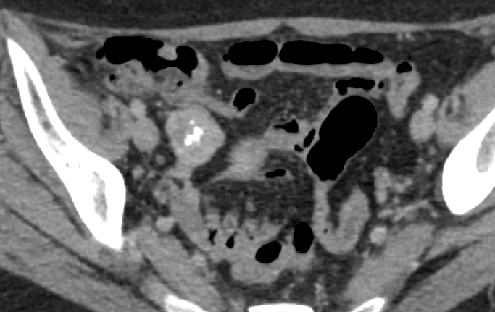
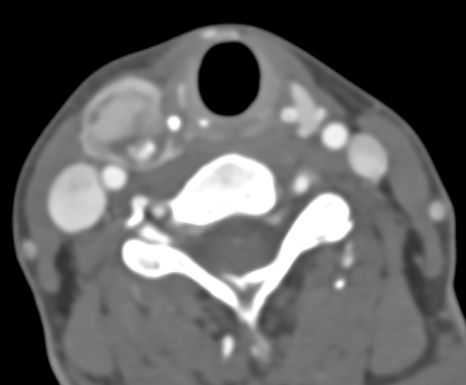
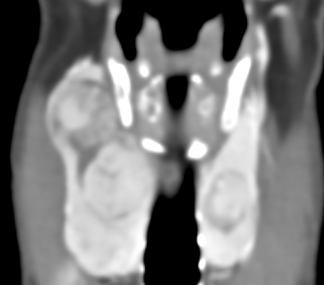
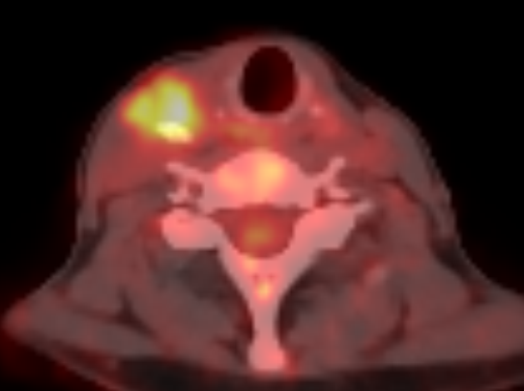
Diagnostic imaging
Enhanced CT of the chest, abdomen and pelvis:
Showed a well-defined lobulated mediastinal soft tissue mass with central coarse internal calcifications.
Right pelvic peritoneal mass with cental calcification, suggestive of matastasis.
Enhanced CT scan of the neck (axial, coronal):
Showed multiple bilateral enhancing thyroid nodules with central calcifications. No suspicious cervical lymph nodes.
PET Scan of the head and Neck:
Intensely hypermetabolic right thyroid nodule.

Slide 4
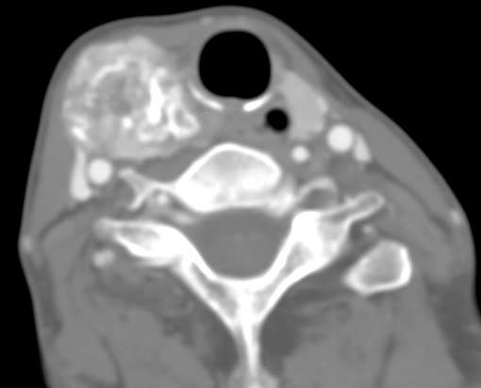
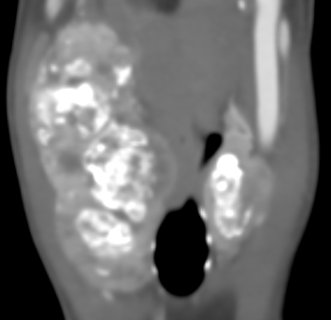
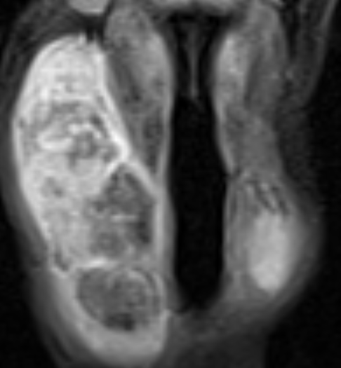
Two years follow-up CT and MRI of the neck
Enhanced CT of the neck (axial and coronal):
Showed interval significant progression in the size and number of the multiple heavily calcified metastatic lesions in the bilateral thyroid lobes. No suspicious cervical lymph nodes.
Enhanced MRI of the neck (coronal T1 pre and post contrast):
Showed corresponding heterogeneous lesions predominantly T1 hypointense signal with associated hemorrhagic components. No evidence of thyroid cartilage or oesopahgus invasion (Not shown). Post-contrast heterogeneous enhancement.

Slide 5
Literature references
Sisu AM, Tatu FR, Stana LG, et al. Chondrosarcoma of the upper end of the femur. Rom J Morphol Embryol 2011;52:709–13.
Simon F, Classe M, Vironneau P, et al. Thyroid compressive mass, a metastasis of femur chondrosarcoma after 14 years: case report and literature review. Braz J Otorhinolaryngol 2017;83:602–4.
Ortiz S, Tortosa F, Sobrinho Simoes M. An extraordinary case of mesenchymal chondrosarcoma metastasis in the thyroid. Endocr Pathol 2015;26:33–6.
Darouassi Y, Touati MM, Chihani M, et al. Chondrosarcoma metastasis in the thyroid gland: a case report. J Med Case Rep 2014;8:157.
Zhi-Hong Wu,Jin-Yao Dai et al. Thyroid metastasis from chondrosarcoma. Wolters Kluwer Health. 2019 Nov 22;98(47):e18043.

