Slide 1
Post Cochlear Implant labyrinthitis ossificans
Dr. Athbi Athab¹, Dr. Hussam AlNeil²
1 Senior Radiologist, Al Amiri Hospital.
2 Consultant Radiologist, Al Sabah Hospital.

Slide 2
3 months old patient presented with bilateral sensorineural hearing loss since birth. Family history was negative for hearing loss and the genetic testing was unremarkable.
Patient was planned for cochlear implant. Pre-implantation HR CT of the petrous bone revealed normal inner structures and cochlear nerves; mild opacification of both mastoid air cells (more on the right) and the hypotympanum of the right middle ear cleft were observed on both sides with prominent nasopharyngeal adenoid.
Ear infection was treated by proper antibiotic and after resolution of the inflammation, the patient underwent bilateral cochlear implants. The surgery was successful, and the patient showed improved hearing on audiologic testing.
2 years later, parents noticed decreased hearing of their child. Audiologic testing revealed left sided sensorineural hearing loss.
Patient was referred for HRCT of the petrous temporal bone to assess for implant integrity and position. CT revealed adequately positioned electrode with no kink, interruption or fold over on either sides. Opacification of the mastoidectomy bed and middle ear was observed on both sides denoting infection. Dense ossification along the left membranous labyrinth, including cochlea lumen, vestibule and semicircular canals, was noted.
Findings were in keeping with left sided labyrinthitis ossificans (LO) as a complication of the cochlear implant surgery.

Slide 3
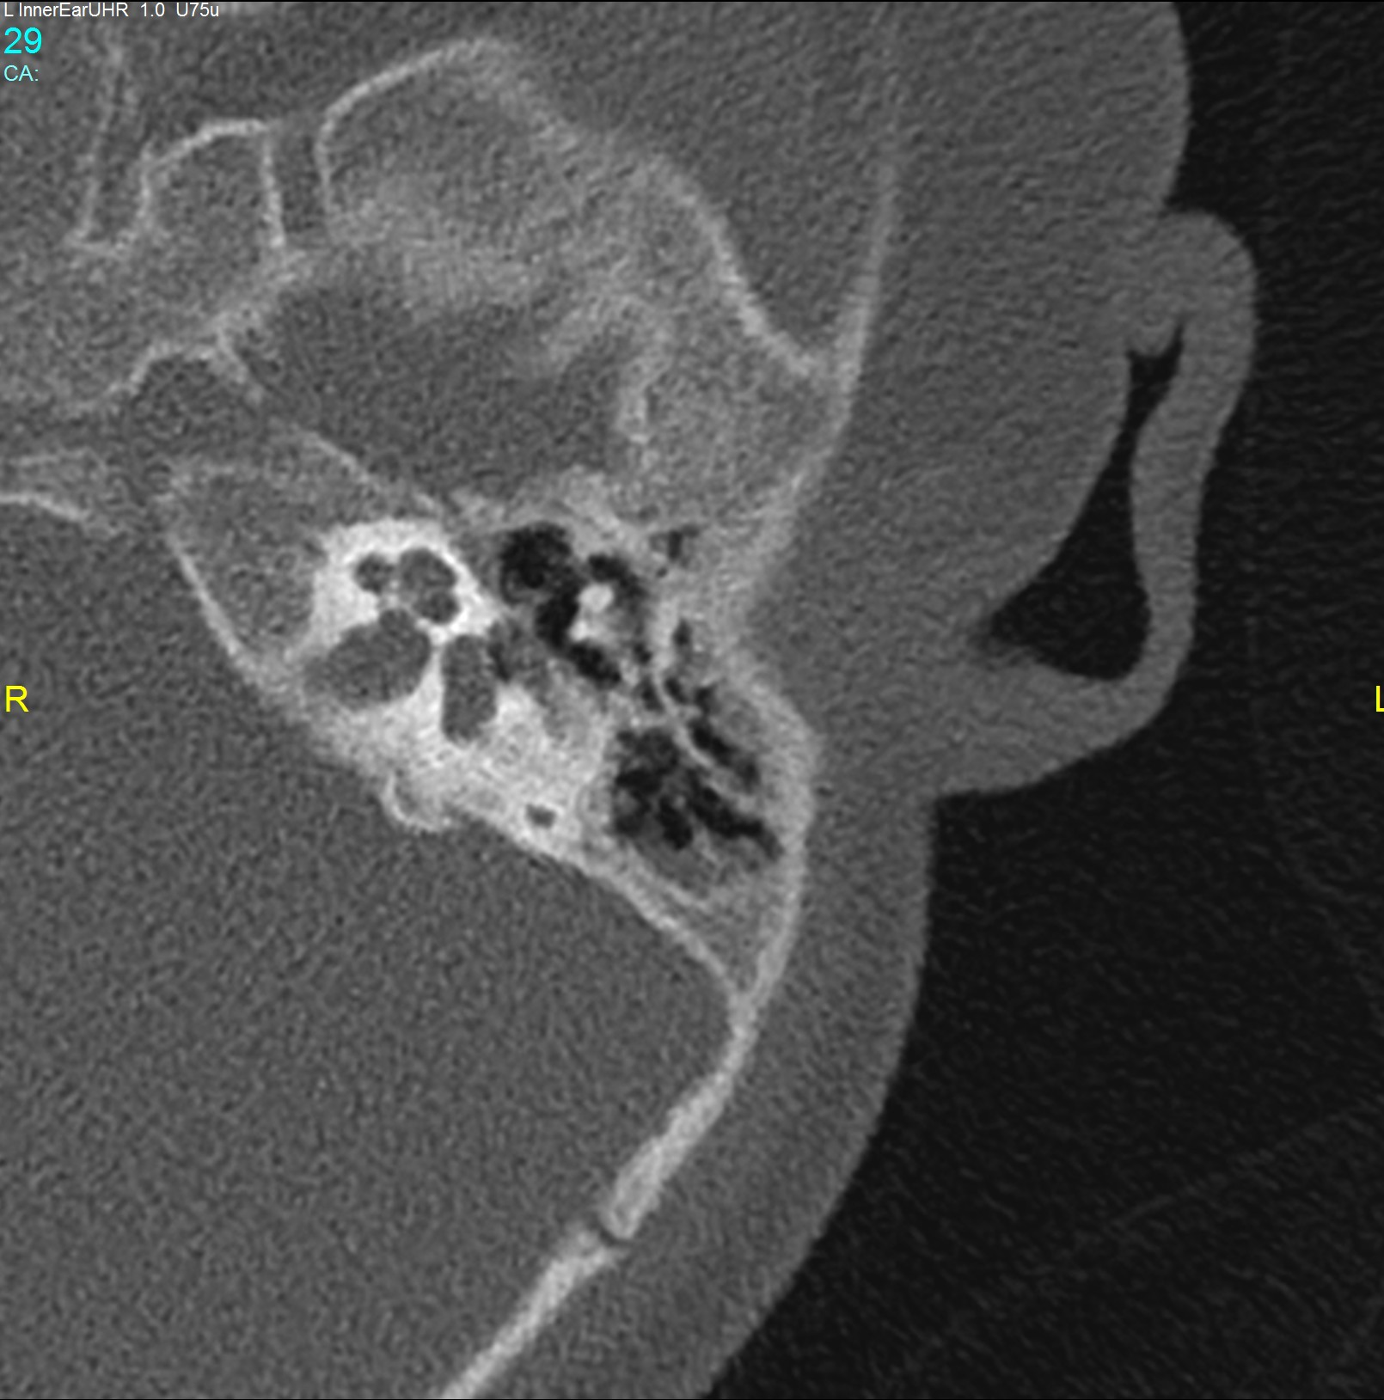
Pre choclear implant HRCT left petrous bone; mild partial opacification of the mastoid air cell (blue arrow) and the middle ear cleft (green arrow).
Normal appearance of the cochlea (orange arrowhead), vestibule (black arrow), semicircular canals (Pink arrow)

Slide 4
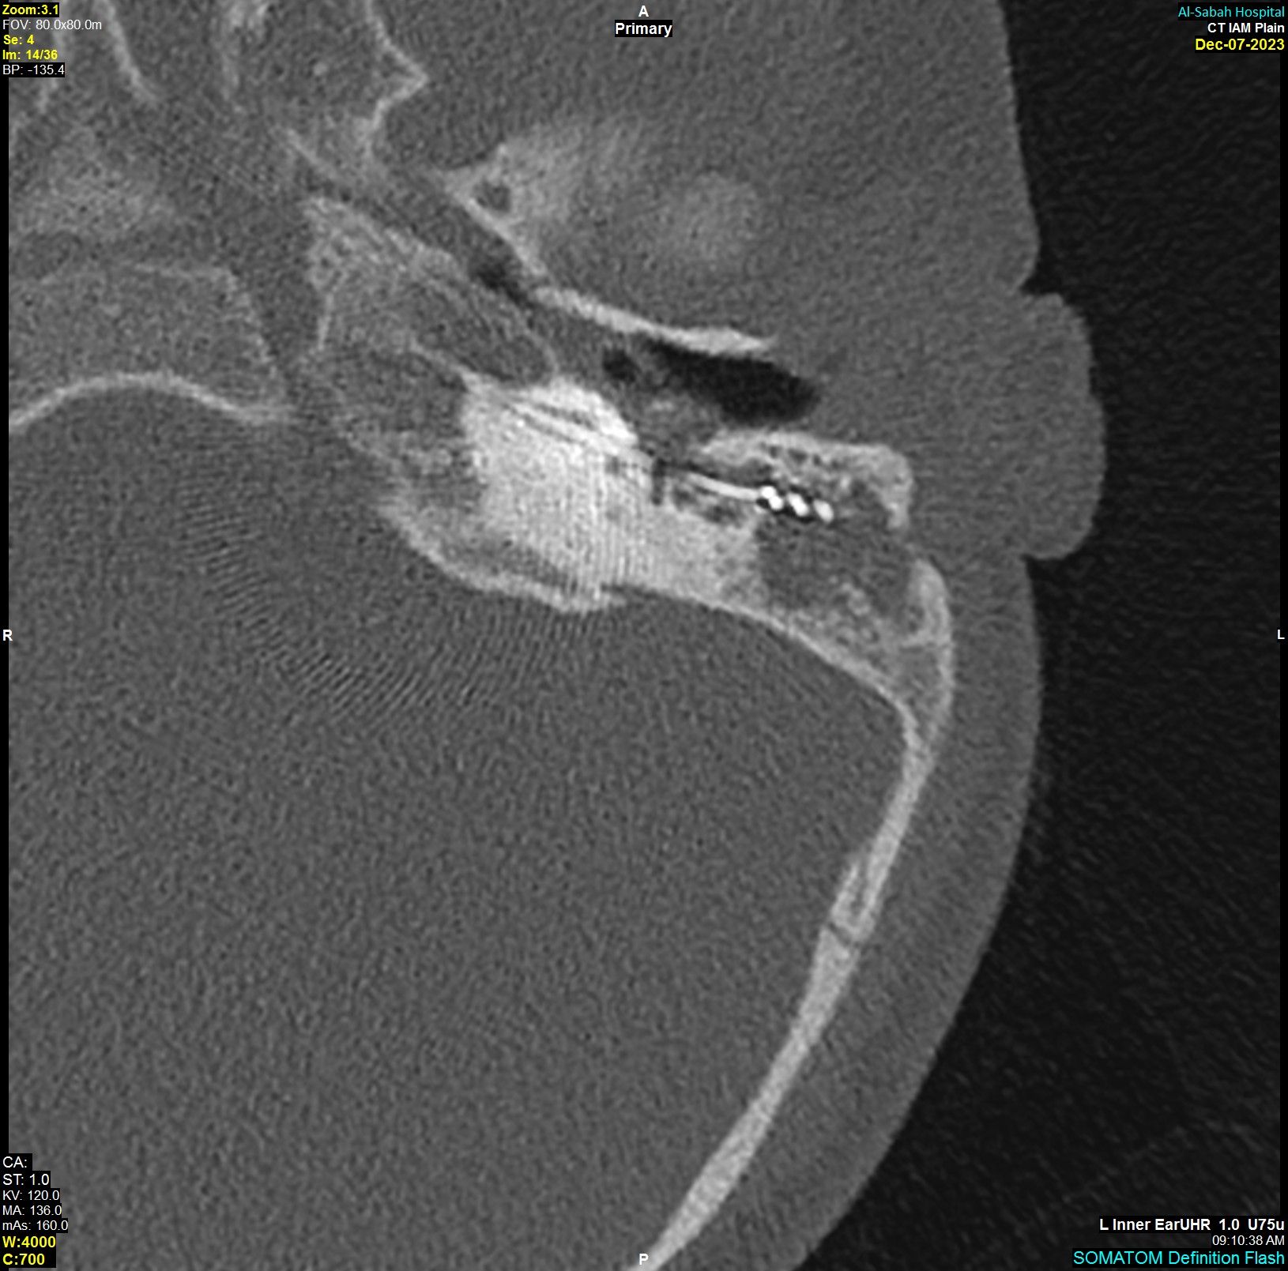
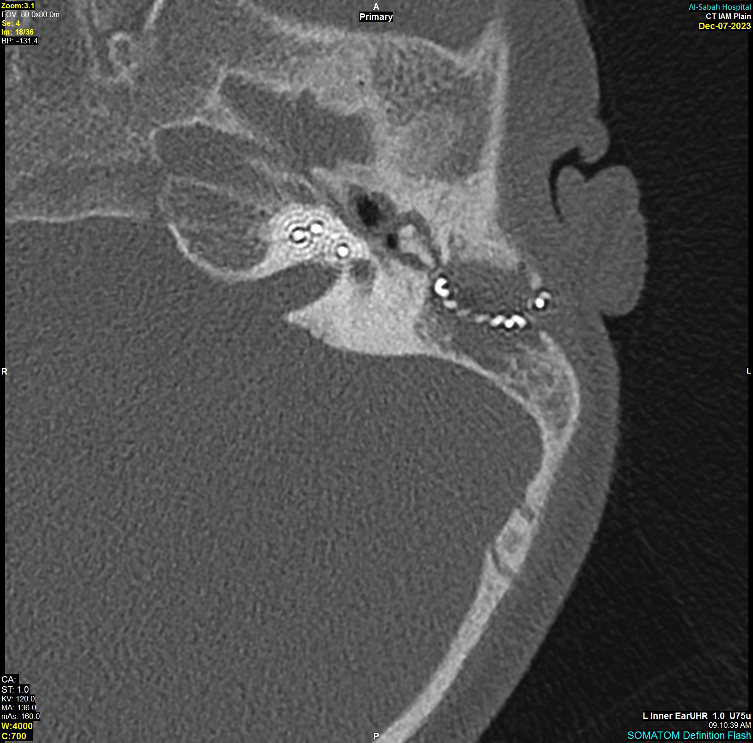
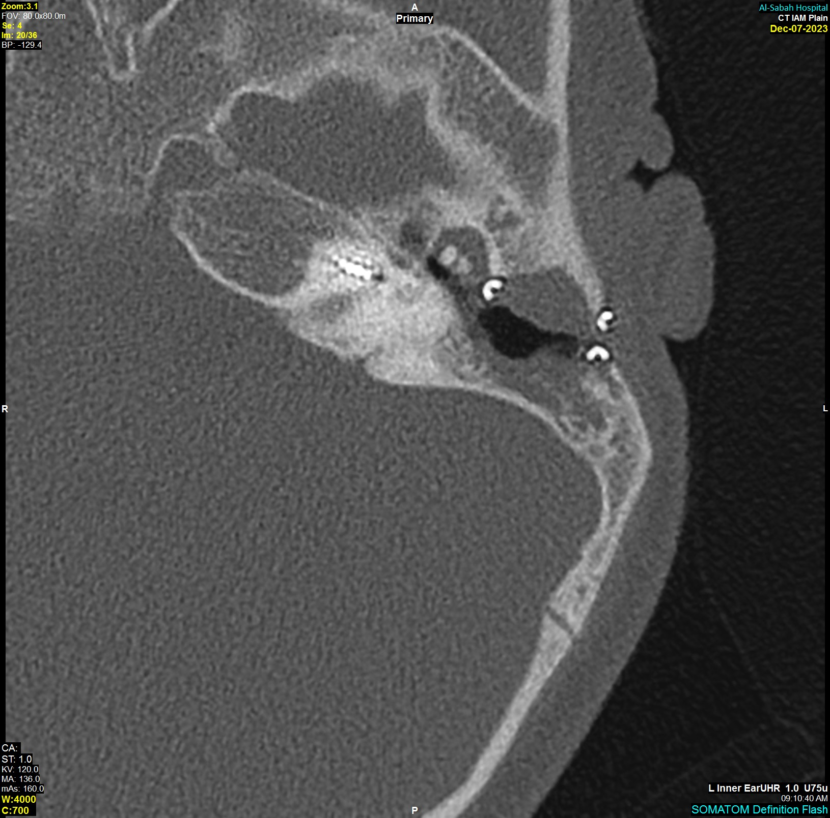
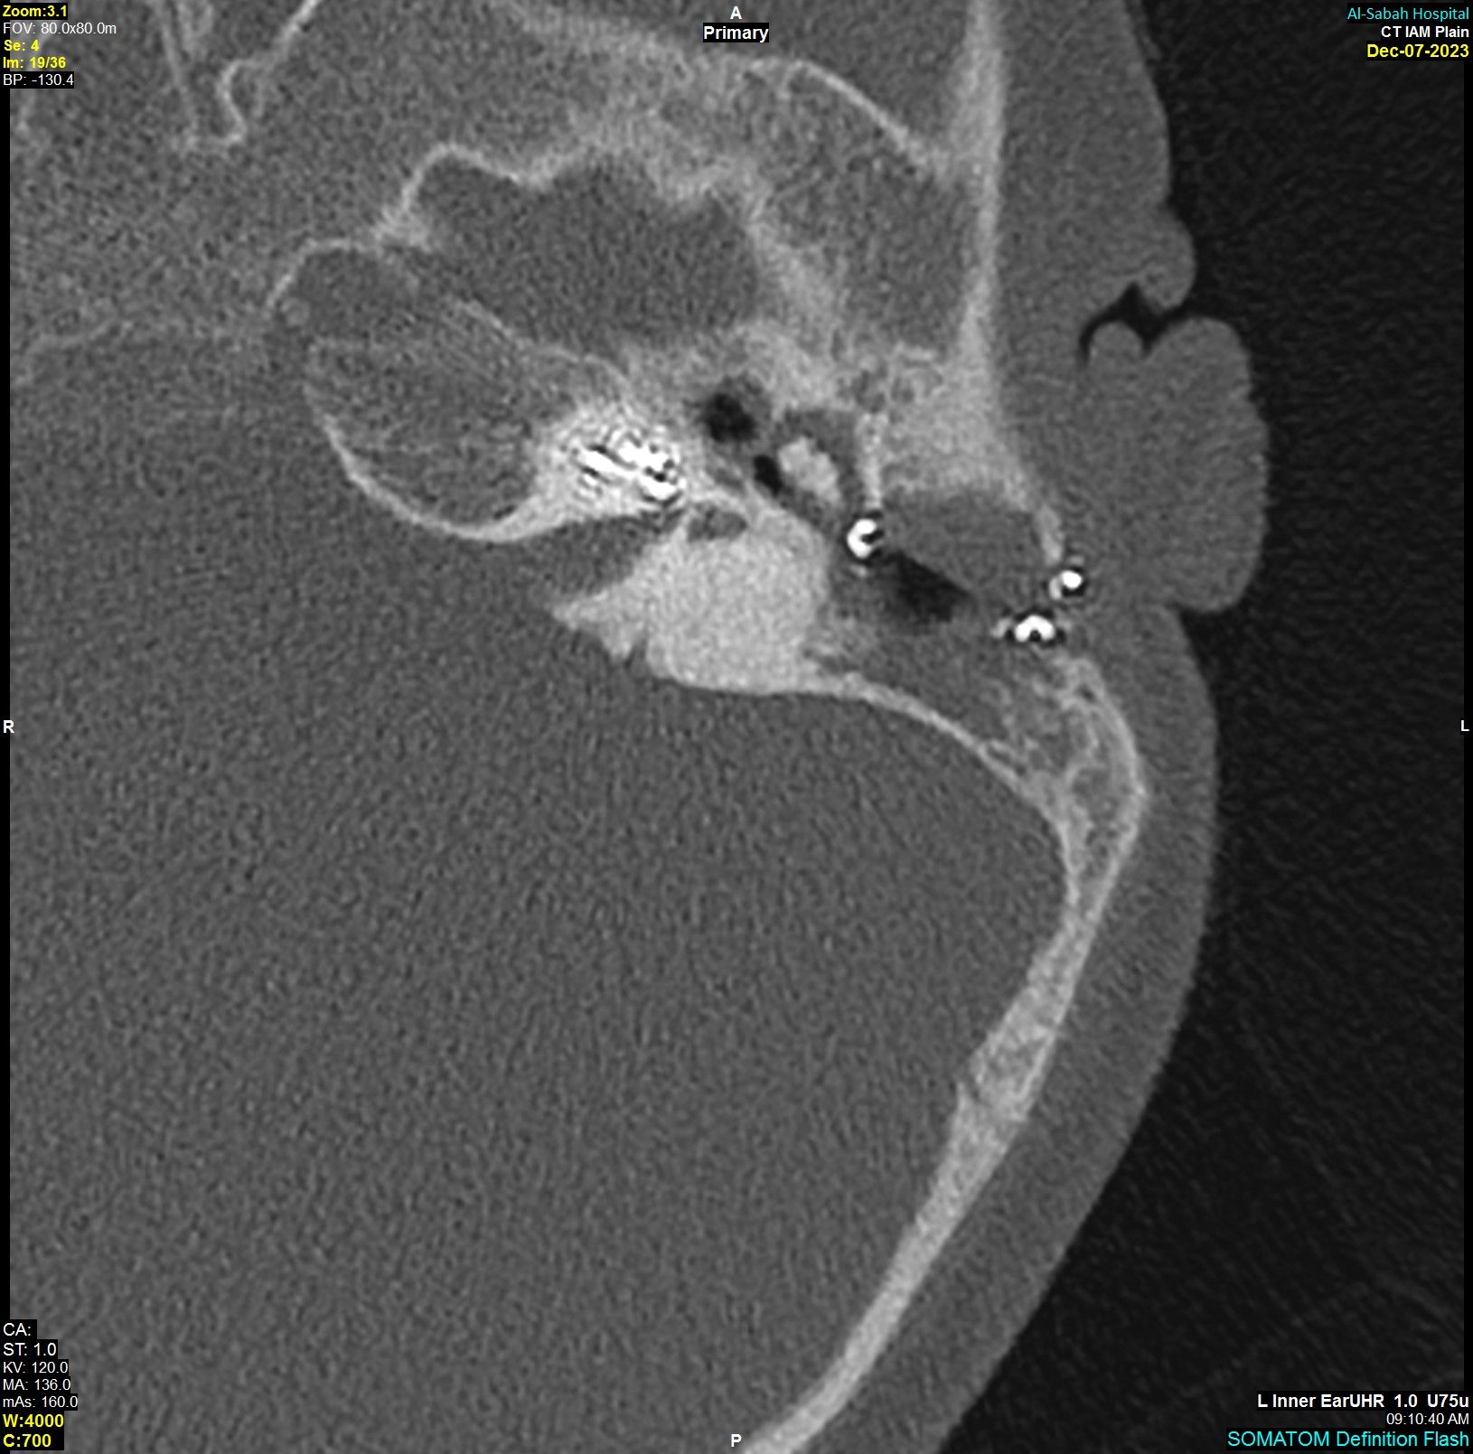
Image (A-D) consecutive axial HRCT images of the left petrous bone. Image (A): High-density bone deposition within the cochlear turns(Blue arrow). Intact cochlear implant electrode(Dashed Blue arrow). Image (B): opacification of the left mastoidectomy operative bed (pink arrows) and the middle ear cleft (green arrow). Image (C): High-density bone deposition within the cochlear turns(blue arrows), vestibule (black arrow) and the SCCC (curved blue arrow). Image (D): High-density bone deposition of the basal turn of the cochlea(Thin orange arrow). The electrode is seen intact and reaching the apical turn of the cochlea (Thick orange arrow).
(A)
(B)
(1)
Image (1) coronal reconstructed image CT of the left petrous bone: Dense bony ossification involving the cochlea (blue arrow), partial opacification of the middle ear cleft (Green arrow).
(C)
(D)

Slide 5
Literature references
Alsalhi, A., Alshawi, Y. A., Alsalhi, H. S., & Hagr, A. (2022). Cochlear implant induced labyrinthine ossificans in Mondini malformation: a case series. Cureus. https://doi.org/10.7759/cureus.32648
Swartz, J. D., Mandell, D. M., Faerber, E. N., Popky, G. L., Ardito, J. M., Steinberg, S. B., & Rojer, C. L. (1985). Labyrinthine ossification: etiologies and CT findings. Radiology, 157(2), 395–398. https://doi.org/10.1148/radiology.157.2.3931172
Buch, K., Baylosis, B., Fujita, A., Qureshi, M., Takumi, K., Weber, P., & Sakai, O. (2019). Etiology-Specific Mineralization Patterns in Patients with Labyrinthitis Ossificans. American Journal of Neuroradiology. https://doi.org/10.3174/ajnr.a5985
Yousem, D. M. (2014). Head and Neck Imaging: Case Review series E-Book: Head and Neck Imaging: Case Review Series E-Book. Elsevier Health Sciences.

