Slide 1
Nasopharyngeal Rhabdomyosarcoma in pediatric patient in complete remission with imaging surveillance for 14 years
First author:
Noura Alraeesi,MD.
King Abdulaziz medical city. Ministry of National Guard Health Affairs, Riyadh, Saudi Arabia.
Correspondence:
Makki AlMuntashri,MD.
King Abdulla International Medical Research Center,
King Saud University for Health Sciences, Ministry of National Guard Health Affairs, Riyadh, Saudi Arabia.
ORCID:0000-0002-7880-8646

Slide 2
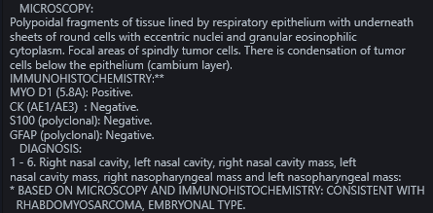
CASE SYNOPSIS
History
18 year old male known case of nasopharyngeal Rhabdomyosarcoma, status post excision and chemoradiotherapy. The patient was diagnosed in 2010, when he presented with difficulty breathing.
Imaging
Chest x-ray: Soft tissue density projecting in the posterior aspect of the nasopharyngeal airway causing narrowing.
Non-enhanced CT of the sinuses: A large soft tissue lesion arising from the nasopharynx extending to the nasal cavity and compressing the adenoid tissue and narrowing the nasopharyngeal airway.
Enhanced MRI of the neck: Corresponding mass exhibiting low and high-signal intensity on both T1 and T2 weighted images with post-contrast heterogeneous enhancement. There was no obvious infiltration of the skull base or focal bone destruction. No suspicious cervical lymph nodes.
MRI exam of the brain: No evidence of parenchymal lesion or abnormal leptomeningeal enhancement.
Bone scan: No scintigraphic evidence of distant skeletal metastases.
Pan-CT: Negative.
Pathology
The pathology confirmed the
diagnosis of Nasopharyngeal Rhabdomyosarcoma,
with no evidence of nodal or
distant metastasis.
Bone marrow biopsy showed no
evidence of bony infiltration.
Management
Functional endoscopic sinus surgery with complete excision of nasopharyngeal mass.
He received chemotherapy for 1 year and currently he is off treatment since 2011.
Yearly MRI follow-up showed no evidence of recurrence.

Slide 3
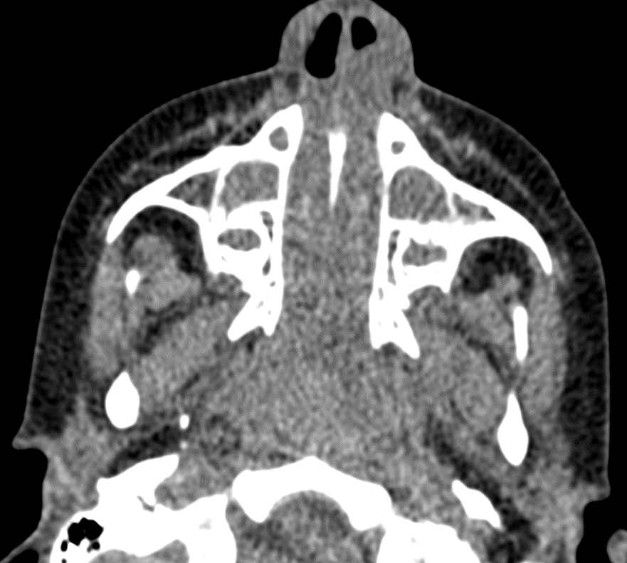
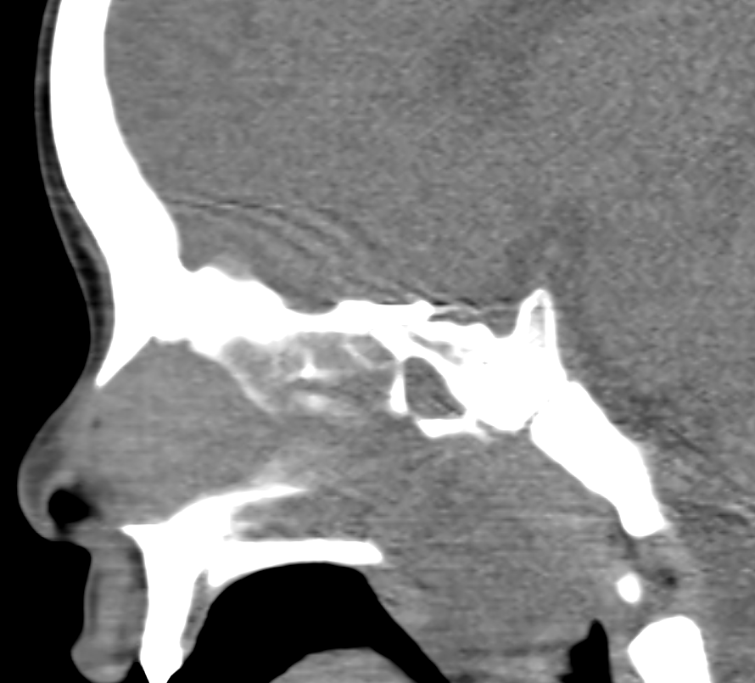
Diagnostic imaging
Lateral cervical spine x-ray;
Soft tissue density projecting in the posterior aspect of the nasopharyngeal airway, causing nasopharyngeal airway narrowing
Plain CT of the paranasal sinuses; axial and sagittal reformates:
Soft tissue density projecting in the posterior aspect of the nasopharyngeal airway displacing the parapharyrngeal fat space laterally, inseparable from the nasal choana. The adenoid tissue is compressed by the mass.

Slide 4
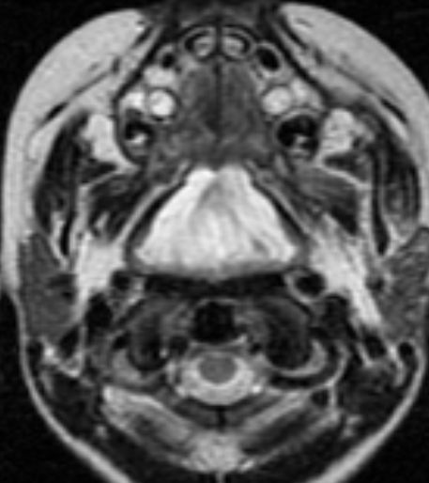
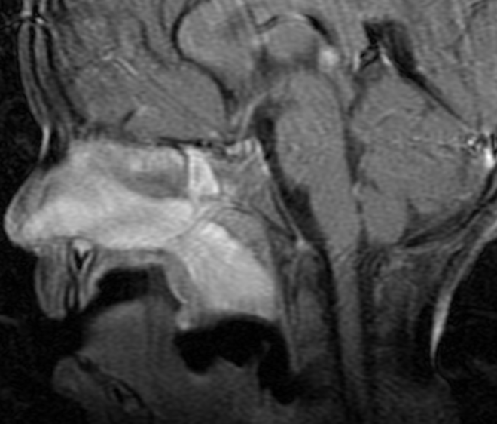
Enhanced MRI of the neck;
Axial T2 WI: Well-defined mass arising from the nasopharyngeal mucosa, exhibiting high T2 weighted images , displacing the nasopharyngeal airway laterally, with no invasion.
Axial T1 WI post-contrast: heterogeneous enhancement of the mass, no features of vascular, perineural or bony invasion.
Sagittal T1 WI post-contrast: Compression of the adenoid tissue, with extension to the nasal cavity. No extension to the oral cavity. Severe narrowing of the nasopharyngeal airway.

Slide 5
Literature references
Van Rijn RR, Wilde JC, Bras J, et al. Imaging findings in noncraniofacial childhood rhabdomyosarcoma. Pediatr Radiol. 2008;38:617–634. doi: 10.1007/s00247-008-0751-y.
Stevens MC, Rey A, Bouvet N, et al. Treatment of nonmetastatic rhabdomyosarcoma in childhood and adolescence: third study of the International Society of Paediatric Oncology—SIOP Malignant Mesenchymal Tumor 89. J Clin Oncol. 2005;23:2618–2628. doi: 10.1200/JCO.2005.08.130.
Hicks J, Flaitz C. Rhabdomyosarcoma of the head and neck in children. Oral Oncol. 2002;38:450–459. doi: 10.1016/S1368-8375(01)00105-1.
Kim EE, Valenzuela RF, Kumar AJ, et al. Imaging and clinical spectrum of rhabdomyosarcoma in children. Clin Imaging. 2000;24:257–262. doi: 10.1016/S0899-7071(00)00222-9.
J N Healy, M F Borg. Paediatric nasopharyngeal rhabdomyosarcoma: A case series and literature review. Journal of medical imaging and radiation oncology. doi:10.1111/j.1754-9485.2010.02187.x.

