Slide 1
Medication-related osteonecrosis of the jaw
(MRONJ)
By: Prof.Dr. Sherif Shama
Consultant Radiologist, Sheikh Jaber Al-Ahmad Al-Sabah Hospital, Kuwait
Professor Of Radio-diagnosis, Head and Neck imaging Unit, Department of Radio-diagnosis, Faculty Of medicine, University Of Alexandria, Egypt.

Slide 2
79 years old male patient with cancer prostate and extensive bony metastasis
-He is on long-term IV bisphosphonates therapy (Zoledronic acid).
-He is presented with non-healing ulcer at the right retromandibular trigone (RMT) with long standing nearby soft tissue cellulitis since 3 months.
-No history of previous irradiation to the mandible.
His CT scans showed:
At the site of the long standing ulcer at the right retromandibular trigone (RMT), there are Interruptions in the mandibular cortex with deep osteonecrosis, superadded osteomyelitis with bony sequestrum extending deep reaching the mandibular canal.
Poorly defined mixed lucent and sclerotic changes within the medulla of the bony mandible.
Widening of the periodontal ligament space of the mandibular teeth with Intact lamina dura.
Soft tissue sheets along the mandible representing tissue edema/infection with underlying diffuse periosteal reaction representing as sclerosis of irregular thickness casting the lingual surface of the mandible.
IV bisphosphonate therapy was temporarily stopped and surgical debridement was performed.

Slide 3
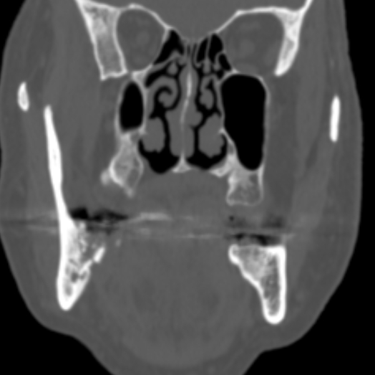
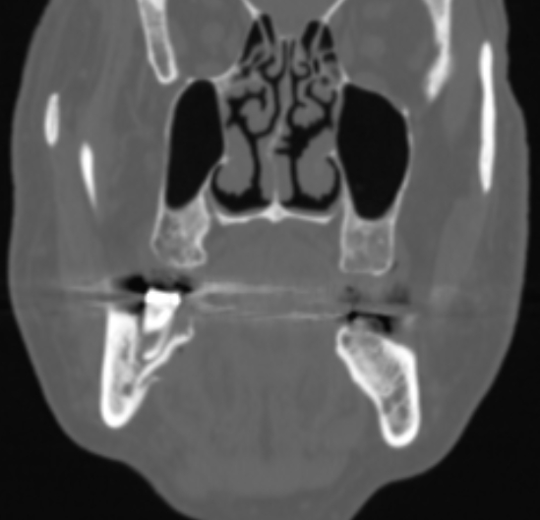
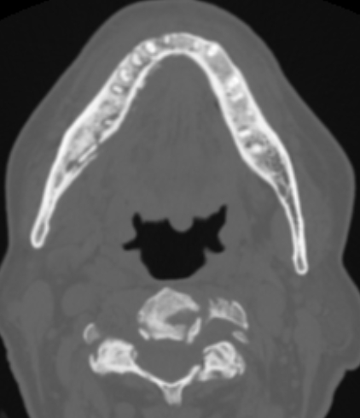
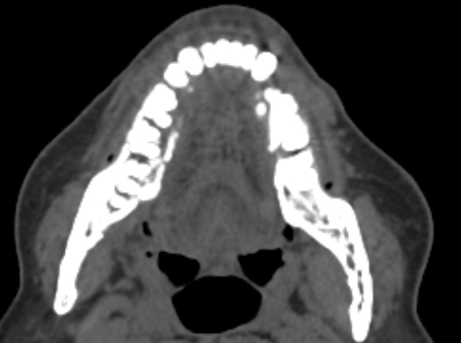
B
C
A
D
CT scans, Coronal (A,B) in bone window. Axial in bone window (D), axial in soft tissue window (D)
The site of the non-healing ulcer at the right retromandibular trigone (green arrows, in A,B) with underlying osteonecrosis, osteomyelitis and sequestrum reaching deep to the mandibular canal (Purple arrows in B,C)
Overlying soft tissue edema and inflammation (yellow arrows in D) with underlying periosteal reaction ( red arrow in C)

Slide 4
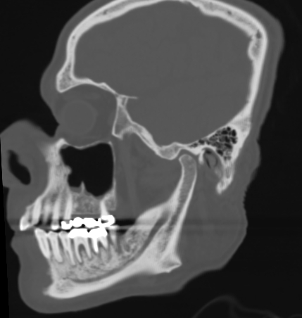
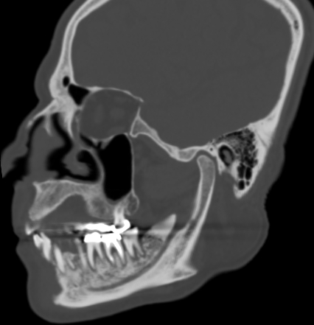
Sagittal oblique CT reconstruction along the right hemi-mandible parallel to the mandibular canal showed
-The site of the non-healing ulcer at the right RMT (green arrow)
-Poorly defined mixed lucent and sclerotic changes within the medulla of the mandible. (Arrow heads)
-Widening of the periodontal ligament space of the mandibular teeth(Purple arrows). Still intact lamina dura (Red arrow)

Slide 5
References
Rosella D, Papi P, Giardino R, Cicalini E, Piccoli L, Pompa G. Medication-Related Osteonecrosis of the Jaw: Clinical and Practical Guidelines. J Int Soc Prev Community Dent. 2016;6(2):97-104. doi:10.4103/2231-0762.178742
Baba A, Goto T, Ojiri H et al. CT Imaging Features of Antiresorptive Agent-Related Osteonecrosis of the Jaw/medication-Related Osteonecrosis of the Jaw. Dentomaxillofac Radiol. 2018;47(4):20170323. doi:10.1259/dmfr.20170323
Ficarra G, Beninati F. Bisphosphonate-related osteonecrosis of the jaws: an update on clinical, pathological and management aspects. Head Neck Pathol. 2007;1 (2): 132-40. doi:10.1007/s12105-007-0033-2
Weerakkody Y, Campos A, Guan H, et al. Medication-related osteonecrosis of the jaw. Reference article, Radiopaedia.org (Accessed on 07 Jan 2025) https://doi.org/10.53347/rID-6784

