Slide 1
Orbital Apex Syndrome (Tolosa Hunt variant)
WALAA ABDULLAH GOUDA¹ and ENAS ABDEL GHANY² And AMAL HASSAN EL SABAGH³
1. CONSULTTANT FARWANIYA HOSPITAL. ASSISTANT PROFESSOR OF RADIODIAGNOSIS MENOFIA UNIVERSITY. EGYPT
2. CONSULTATANT. FARWANIYA HOSPITAL PROFESSOR OF RADIODIAGNOSIS AIN SHAMS UNIVERSITY. EGYPT
3. SENIOR OF RADIODIAGNOSIS FARWANIYA HOSPITAL.

Slide 2
History:
A 45 -year-old female patient presented with headache which was severe in intensity, pain around the right eye for three days, followed by diminution of vision and dropping of the upper lid. There was no history of fever, trauma, ocular surgery.
Imaging findings:
CT shows an ill-defined soft tissue thickening centered upon the right orbital apex showing mild enhancement and seen involving the recti muscles as well as extending along the superior orbital fissure to the right cavernous sinus, reaching the petrego-palatine fossa and nearby infratemporal fossa via the inferior orbital fissure.
On MRI the right orbital apex soft tissue thickening shows the same extensions and displaying iso signal in T1 and low signal in T2WI with moderate post contrast enhancement.
Final diagnosis: non specific (idiopathic) orbital apex inflammation (Tolosa Hunt variant)
Discussion:
Orbital apex disorders include orbital apex , superior orbital fissure and cavernous sinus syndromes.
These disorders result from various aetiologies, including trauma, neoplastic, developmental, infectious, inflammatory as well as vascular causes. These three disorders share similar causes, diagnostic evaluation and management strategies. The aetiology is diverse and management is directed to the causative process.
Treatment the patient was treated with corticosteroids under frequent and close observation with complete resolution of the patient condition with no relapse reported along the 6 months follow up.

Slide 3
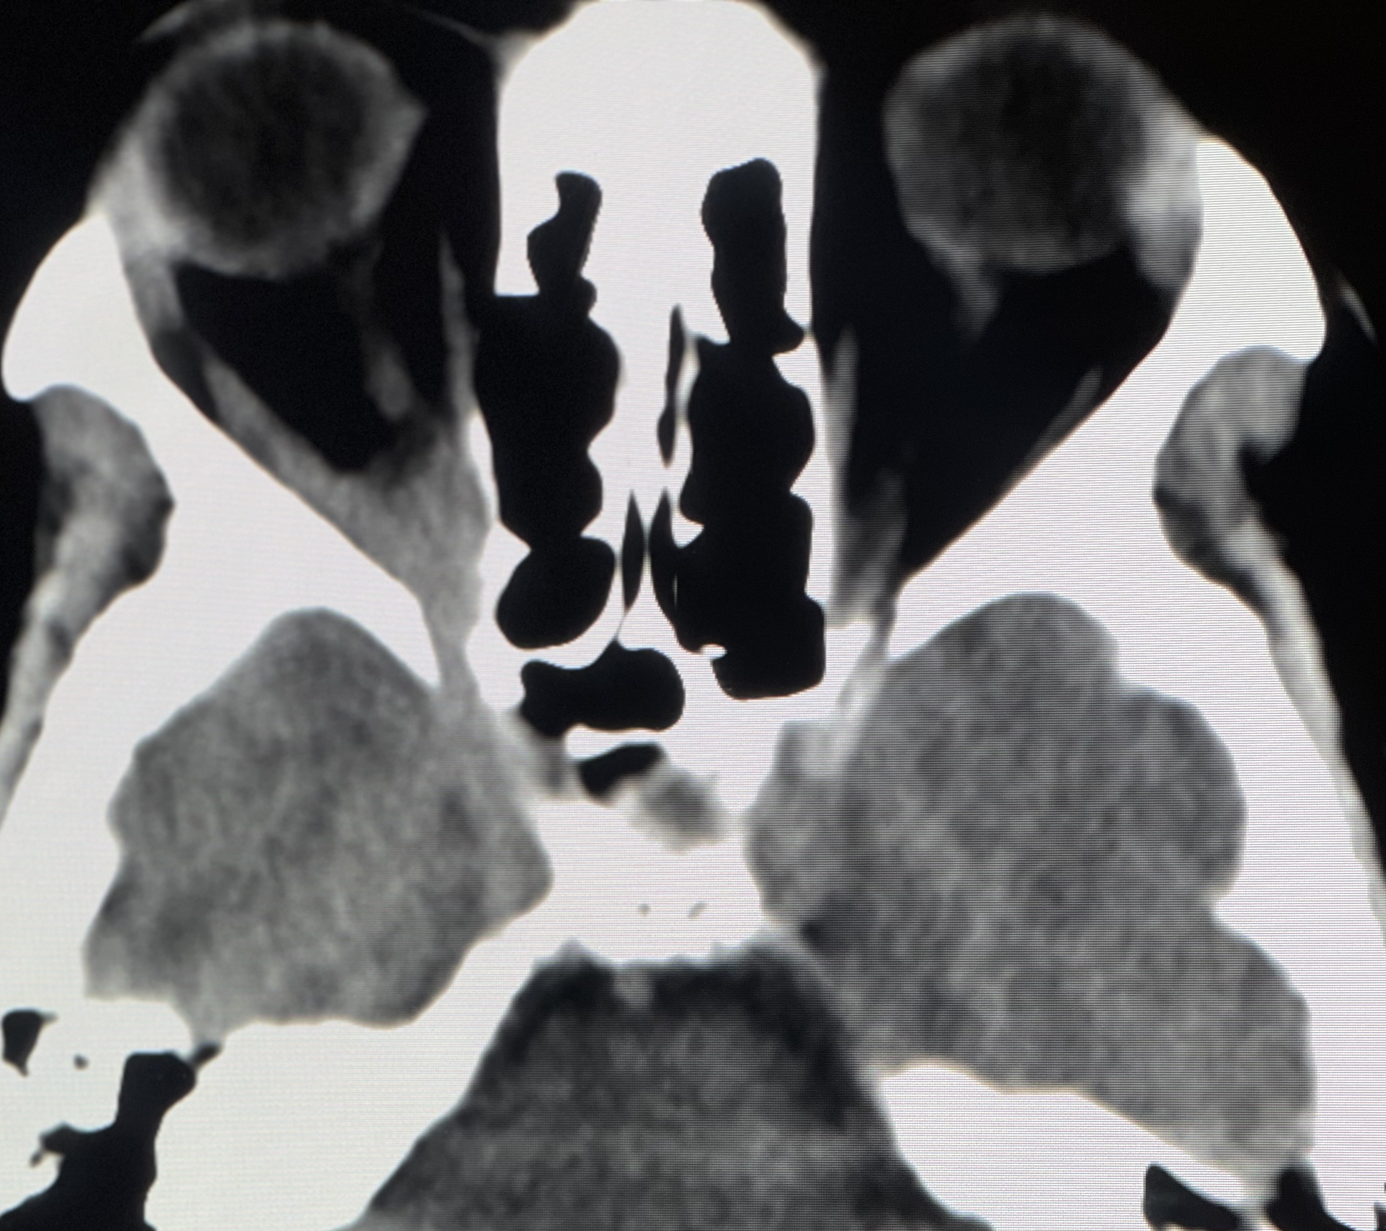
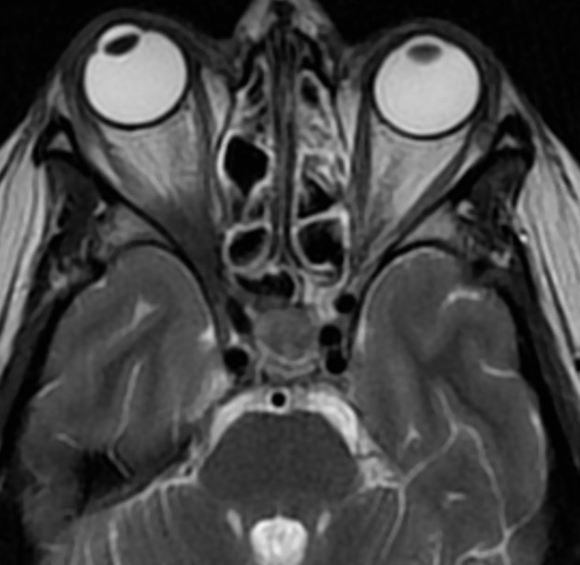
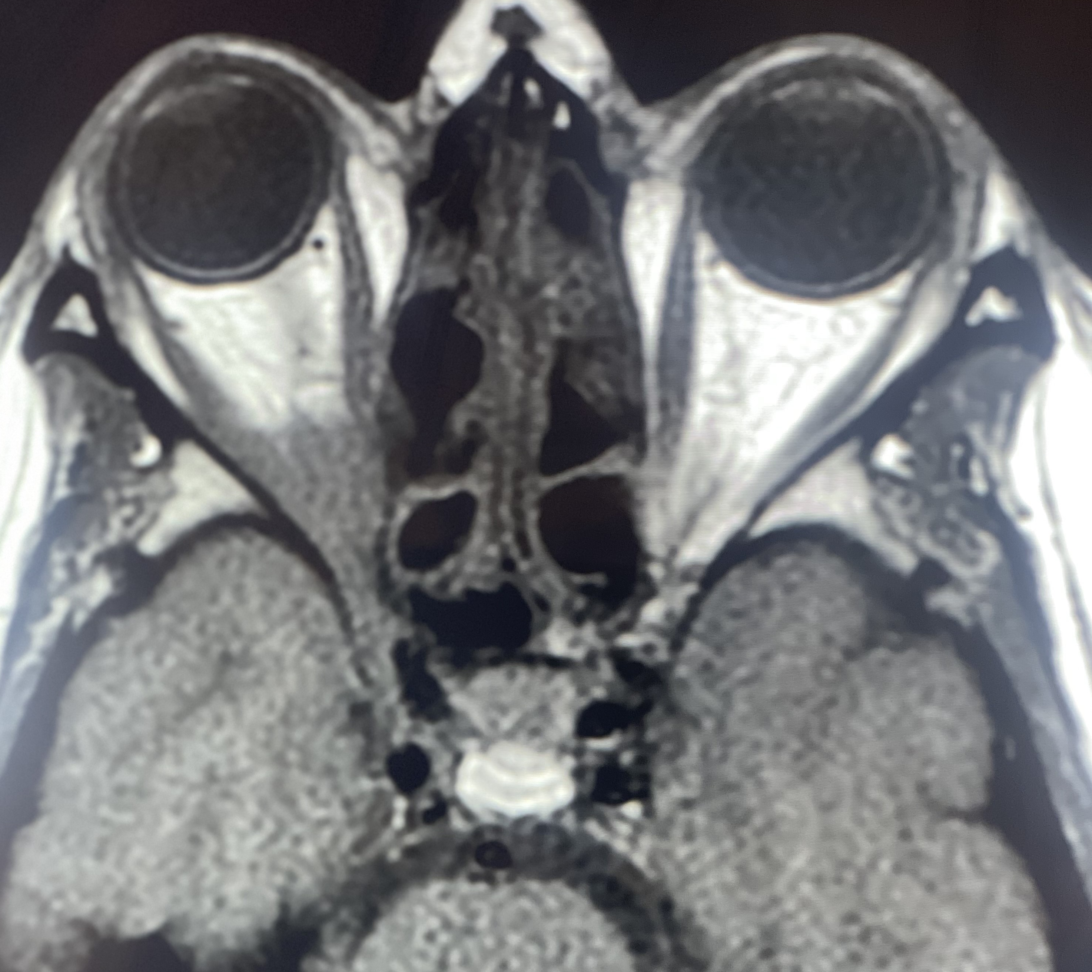
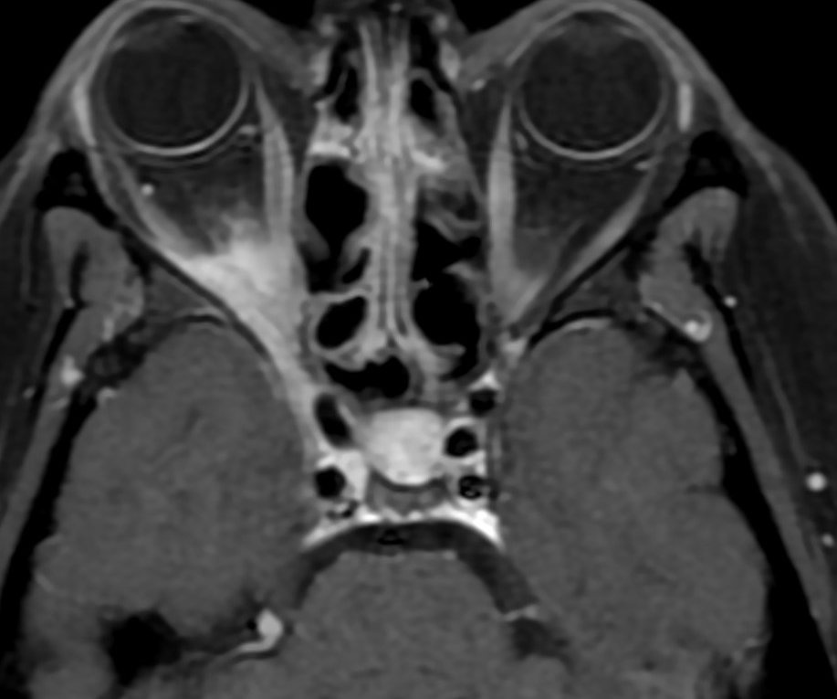
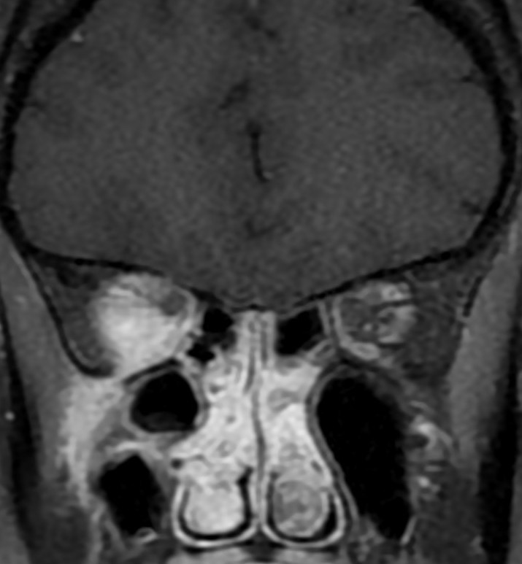
A
B
D
C
E
F
G
H
CT images, :A&B Axial pre and post contrast images C: coronal post contrast shows slightly hypodense mildly enhancing soft tissue thickening at the right orbital apex (green arrow) with ocular muscle enlargement (blue arrow) and extension to the right cavernous sinus (white arrow).
MR: D: axial T2 showing the orbital apex thickening with low signal , E&F: axial FLAIR &T1 show intermediate & iso signal intensity respectively(green arrow). G&H: axial and coronal post contrast T1 images showing moderate homogenous enhancement of the orbital apex lesion extending to the right cavernous sinus (white arrow) and the right infratemporal fossa (yellow arrow).

Slide 4
References.
Badakere A, Patil-Chhablani P. Orbital Apex Syndrome: A Review. Eye Brain. 2019;11:63-72.
Pfeiffer ML, Merritt HA, Bailey LA, Richani K, Phillips ME. Orbital apex syndrome from bacterial sinusitis without orbital cellulitis. Am J Ophthalmol Case Rep. 2018;10:84-86.
Cho SH, Jin BJ, Lee YS, Paik SS, Ko MK, Yi HJ. Orbital apex syndrome in a patient with sphenoid fungal balls. Clin Exp Otorhinolaryngol. 2009;2(1):52-4.

